Slide 1
Charging Ahead
Exploring the ev market in romania
A marketing study by
al Sammarraie Nooruldeen
Litescu David Adrian
Gagiu Casandra

Slide 2
Introduction to the market
Global Growth:
Annual sales of battery electric vehicles are surging, with a remarkable 50%+ year-on-year increase
Europe has emerged as a strong market, selling over 1.3 million electric cars within eight years.
Romania's electric vehicle market is in its early stages, with only 40,000 registered electric automobiles.
Compared to the 2022 the registered number of EVs have increased by 60% in 2023, which shows huge room for improvement.
Electric vehicle adoption is accelerating globally, driven by sustainability awareness and technological advancements.
Romania shows promising potential for electric vehicle growth, with significant increases in registrations over recent years.

Slide 3
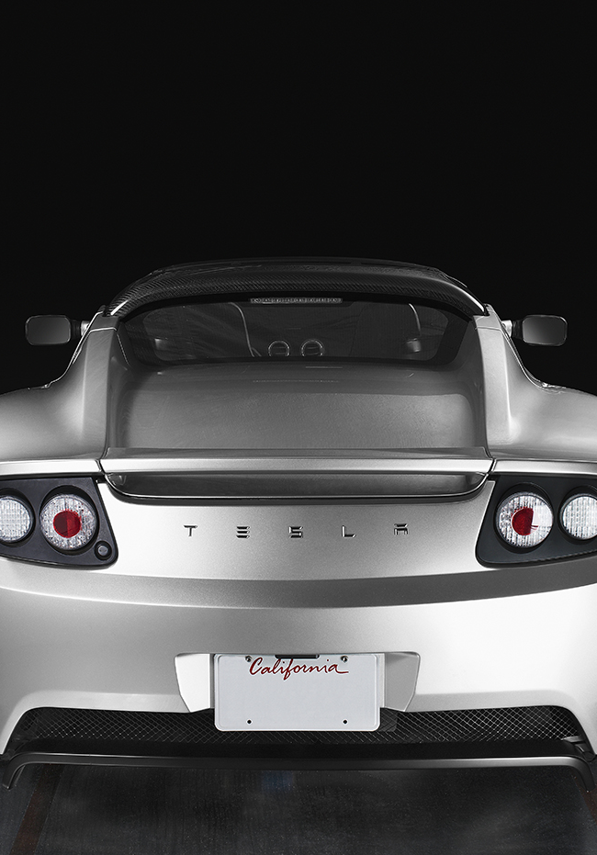
Market analysis
Battery Electric Vehicles experienced a remarkable increase of 14.2% compared to the previous year.
Full electric cars held a 24.4% market share in 2023, up from 10.7% the previous year, representing a significant increase of 13.7% in purchases compared to 2022.
The data also reveals substantial growth in electrified cars: 100% electric cars increased by 31.9%
Despite challenges, electrified cars are expected to remain in focus with an estimated overall growth of 24.4%.

Slide 4

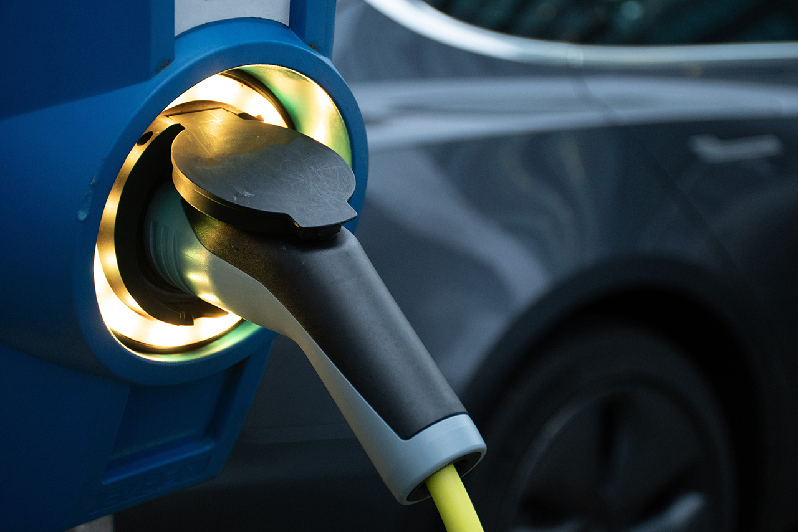
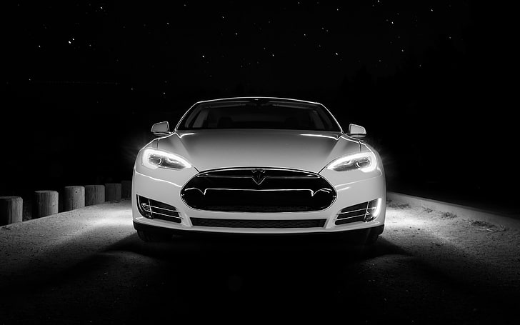
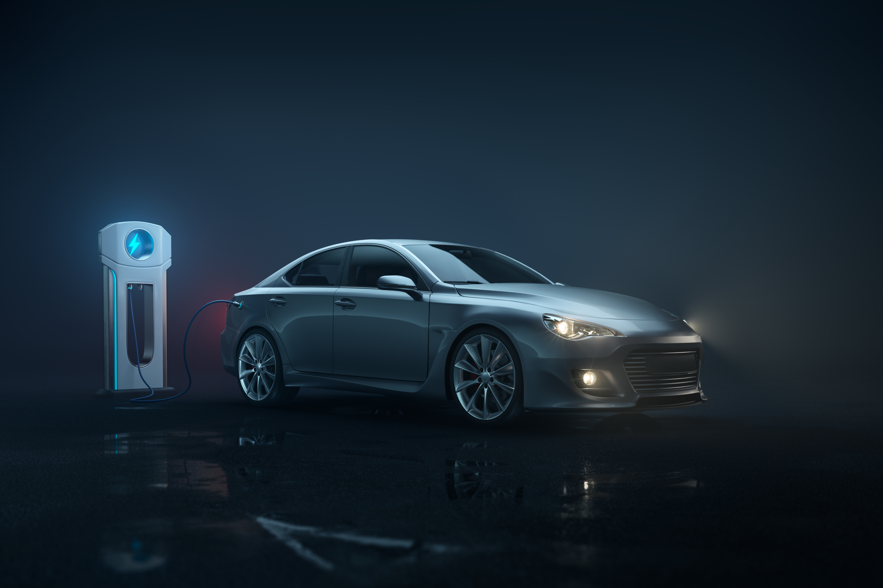

Analyzing tesla
Tesla is a leading player in the EV sector worldwide however not in Romania, renowned for its cutting-edge technology and sleek designs.
Key Tesla models making an impact in Romania include the Tesla Model Y and Tesla Model 3, reflecting strong sales figures in the Romania.
Despite being a newcomer in Romania's automotive scene, Tesla has quickly gained traction, offering compelling alternatives to traditional combustion vehicles.

Slide 5

tesla swot
A top employer company
Most valuable automotive company
Tesla doubles its electric vehicle delivery
Innovative company
Better positioned
Strengths
Weaknesses
Manufacturing complications
Unable to meet demand might affect brand value
Lack of high volume production
Shortage of batteries
Financial uncertainty
Sales expansion in untapped market
Less expensive car
Bringing battery production technology in-house
Introduction of pick-up truck
Market confidence in Tesla
Product liability claims
Extensive competition
Self-driving cars are still a concern for pedestrians
High-risk factor due to usage of Lithium-ion
Opportunities
Threats

Slide 6
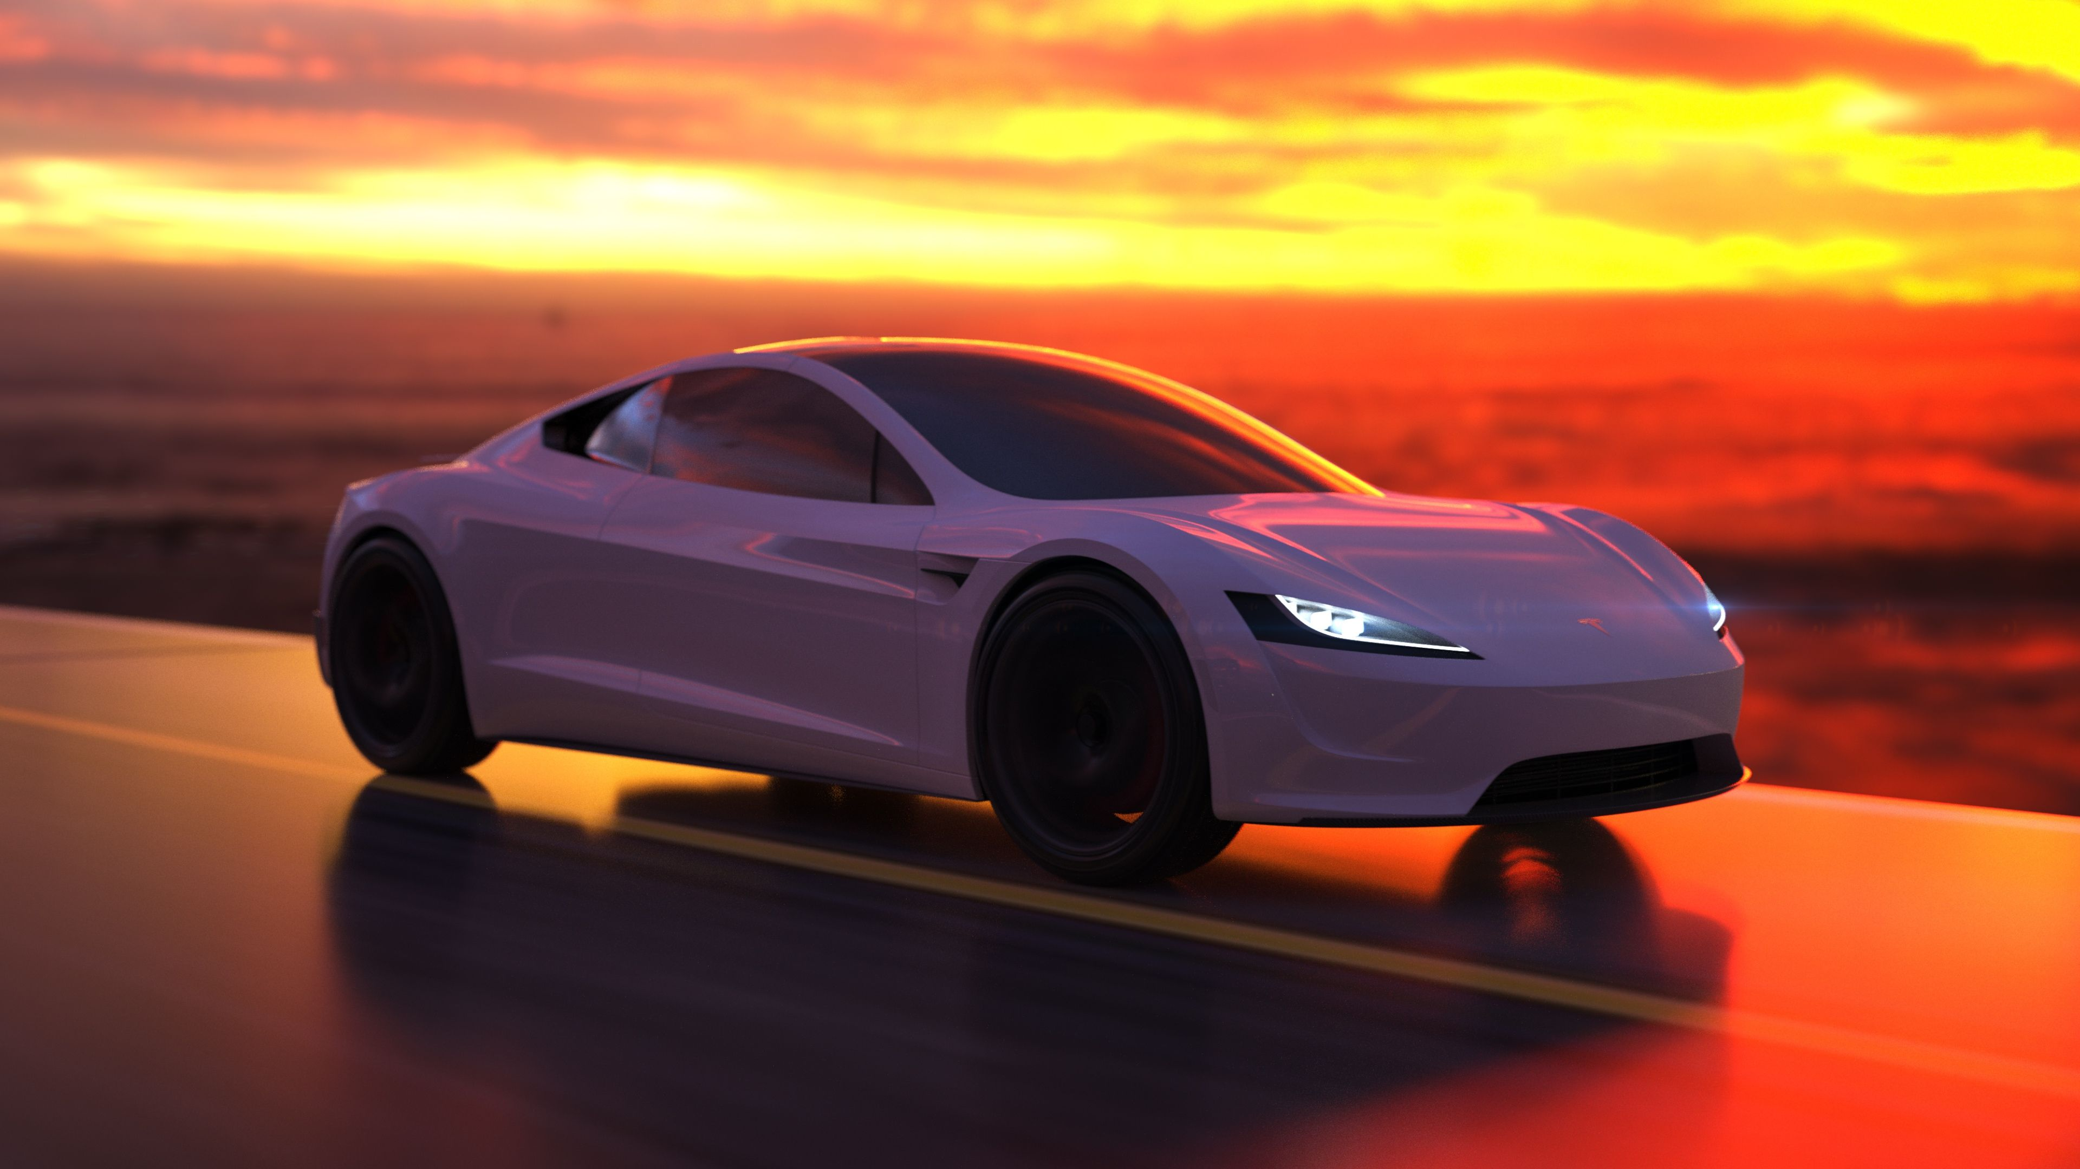
Product offerings
Continuously improve existing models with updates such as longer battery life, faster charging times, and enhanced autonomous driving features. This leverages Tesla’s strength in innovation and technology.
Introduce new vehicle types, such as compact SUVs or electric pickup trucks, to tap into different market segments and address weaknesses like limited vehicle variety.
Continue investing in cutting-edge technologies like AI-driven driving assistance, renewable energy integration for homes, and advancements in battery technology to maintain Tesla’s reputation as an industry leader.

Slide 7
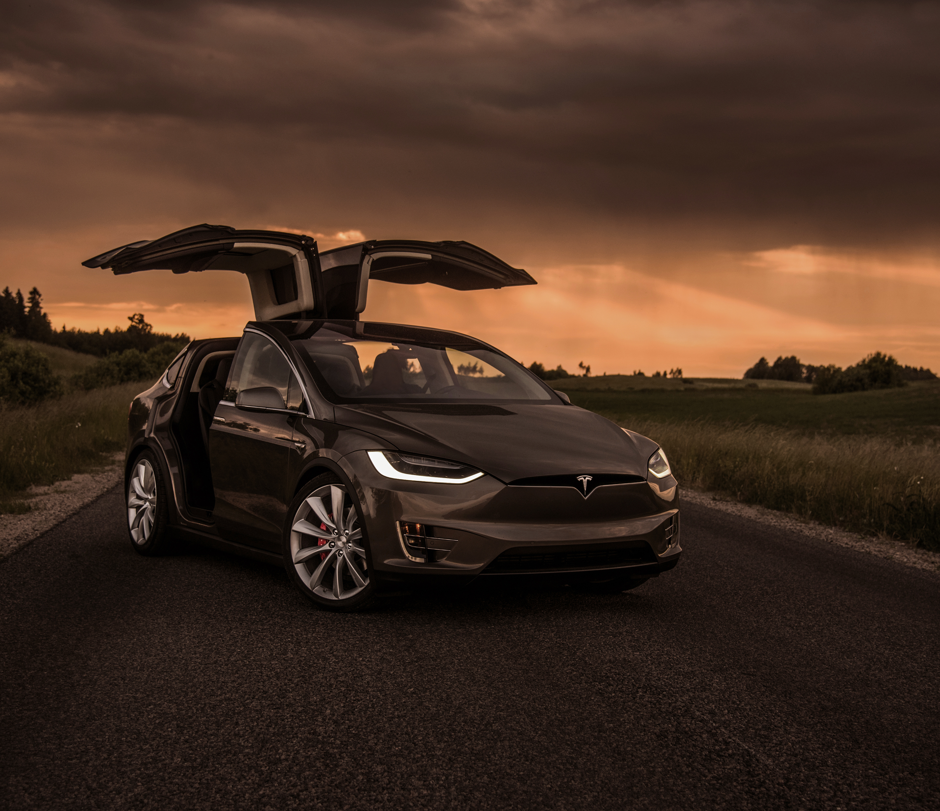
Target market
Focus on affluent eco-conscious consumers who value sustainability and cutting-edge technology, aligning with Tesla’s brand image and strengths in innovation.
Target emerging markets aggressively, leveraging opportunities for growth in regions with increasing awareness and demand for electric vehicles.
Tailor marketing campaigns for specific segments such as urban commuters, families, and luxury car enthusiasts, highlighting unique features and benefits that resonate with each group.

Slide 8

Pricing strategies
Maintain competitive prices compared to other high-end EV manufacturers while continuing the high end performance.
Emphasize the long-term cost savings of owning an electric vehicle to justify premium pricing, aligning with opportunities in the market shift towards sustainable practices.
Offer incentives such as tax credits, referral bonuses, and financing options to make Tesla vehicles more accessible, addressing potential threats like competition from traditional automakers entering the EV market.

Slide 9
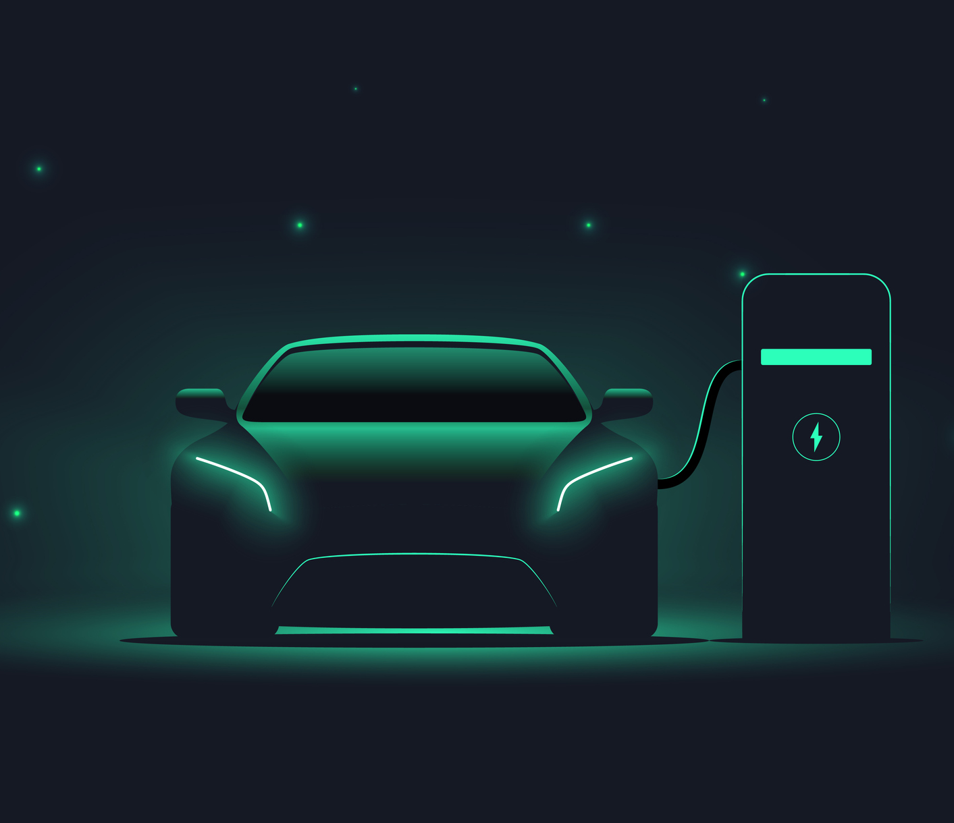
distribution channels
Increase presence in key markets globally by expanding physical stores, service centers, and Supercharger networks, leveraging opportunities for global market penetration.
Optimize distribution channels based on market demand and consumer behavior data, ensuring efficient inventory management and timely product availability.
Strengthen online sales channels, offering customization options, virtual test drives, and seamless purchasing processes to cater to digital-savvy customers, aligning with strengths in technology and innovation.

Slide 10
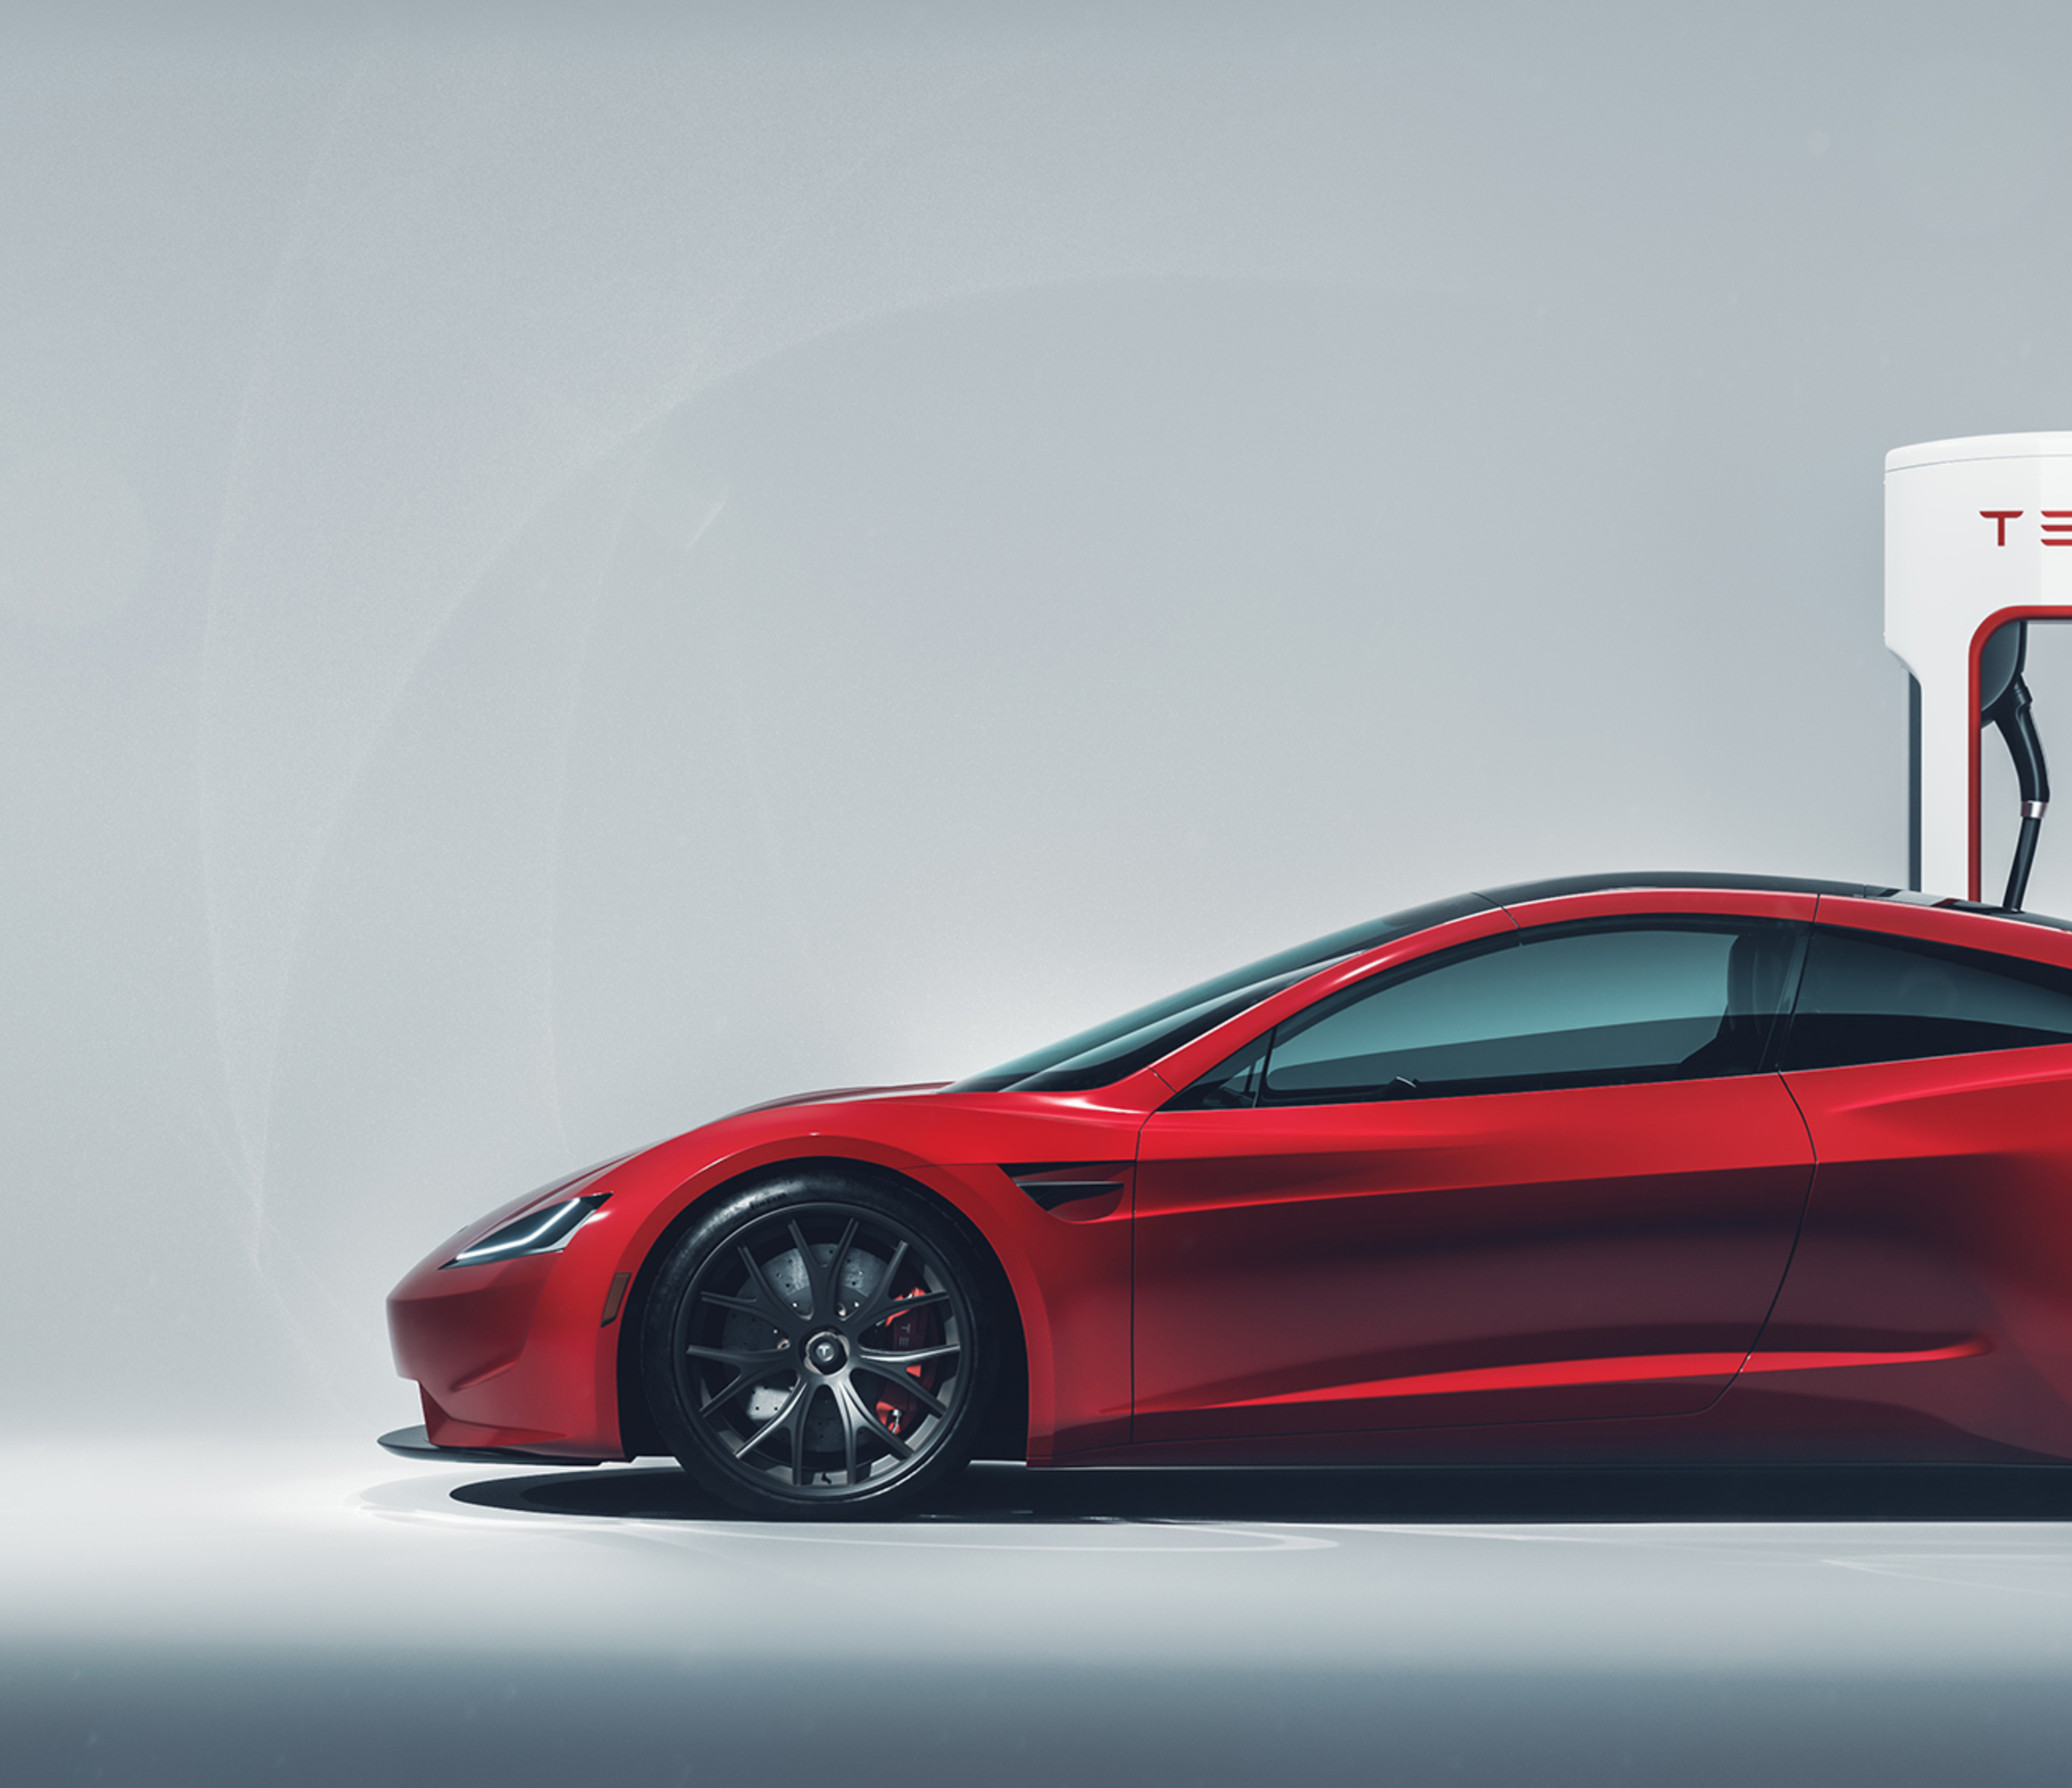
promotional activities
Utilize a mix of traditional media and digital platforms to showcase Tesla’s technological advancements, and sustainability efforts leveraging their strengths.
Launch engaging campaigns on platforms like Instagram, TikTok, and Twitter (x) to build brand awareness, engage with younger demographics, and highlight user-generated content and testimonials.
Collaborate with eco-friendly brands, tech companies, and influencers to reach new audiences, showcase product integration opportunities, and strengthen Tesla’s positioning as a lifestyle brand.

Slide 11

customer relationship
Enhance post-purchase support, streamline service processes, and invest in training for service staff to ensure exceptional customer experiences, addressing weaknesses in service quality.
Introduce rewards programs for repeat customers, offering perks like exclusive events, early access to new features, and discounts on accessories or service packages, fostering customer loyalty and retention.

Slide 12
Charging Ahead
A road towards the future
A marketing study by
al Sammarraie Nooruldeen,
Litescu David Adrian,
Gagiu Casandra

