Slide 1
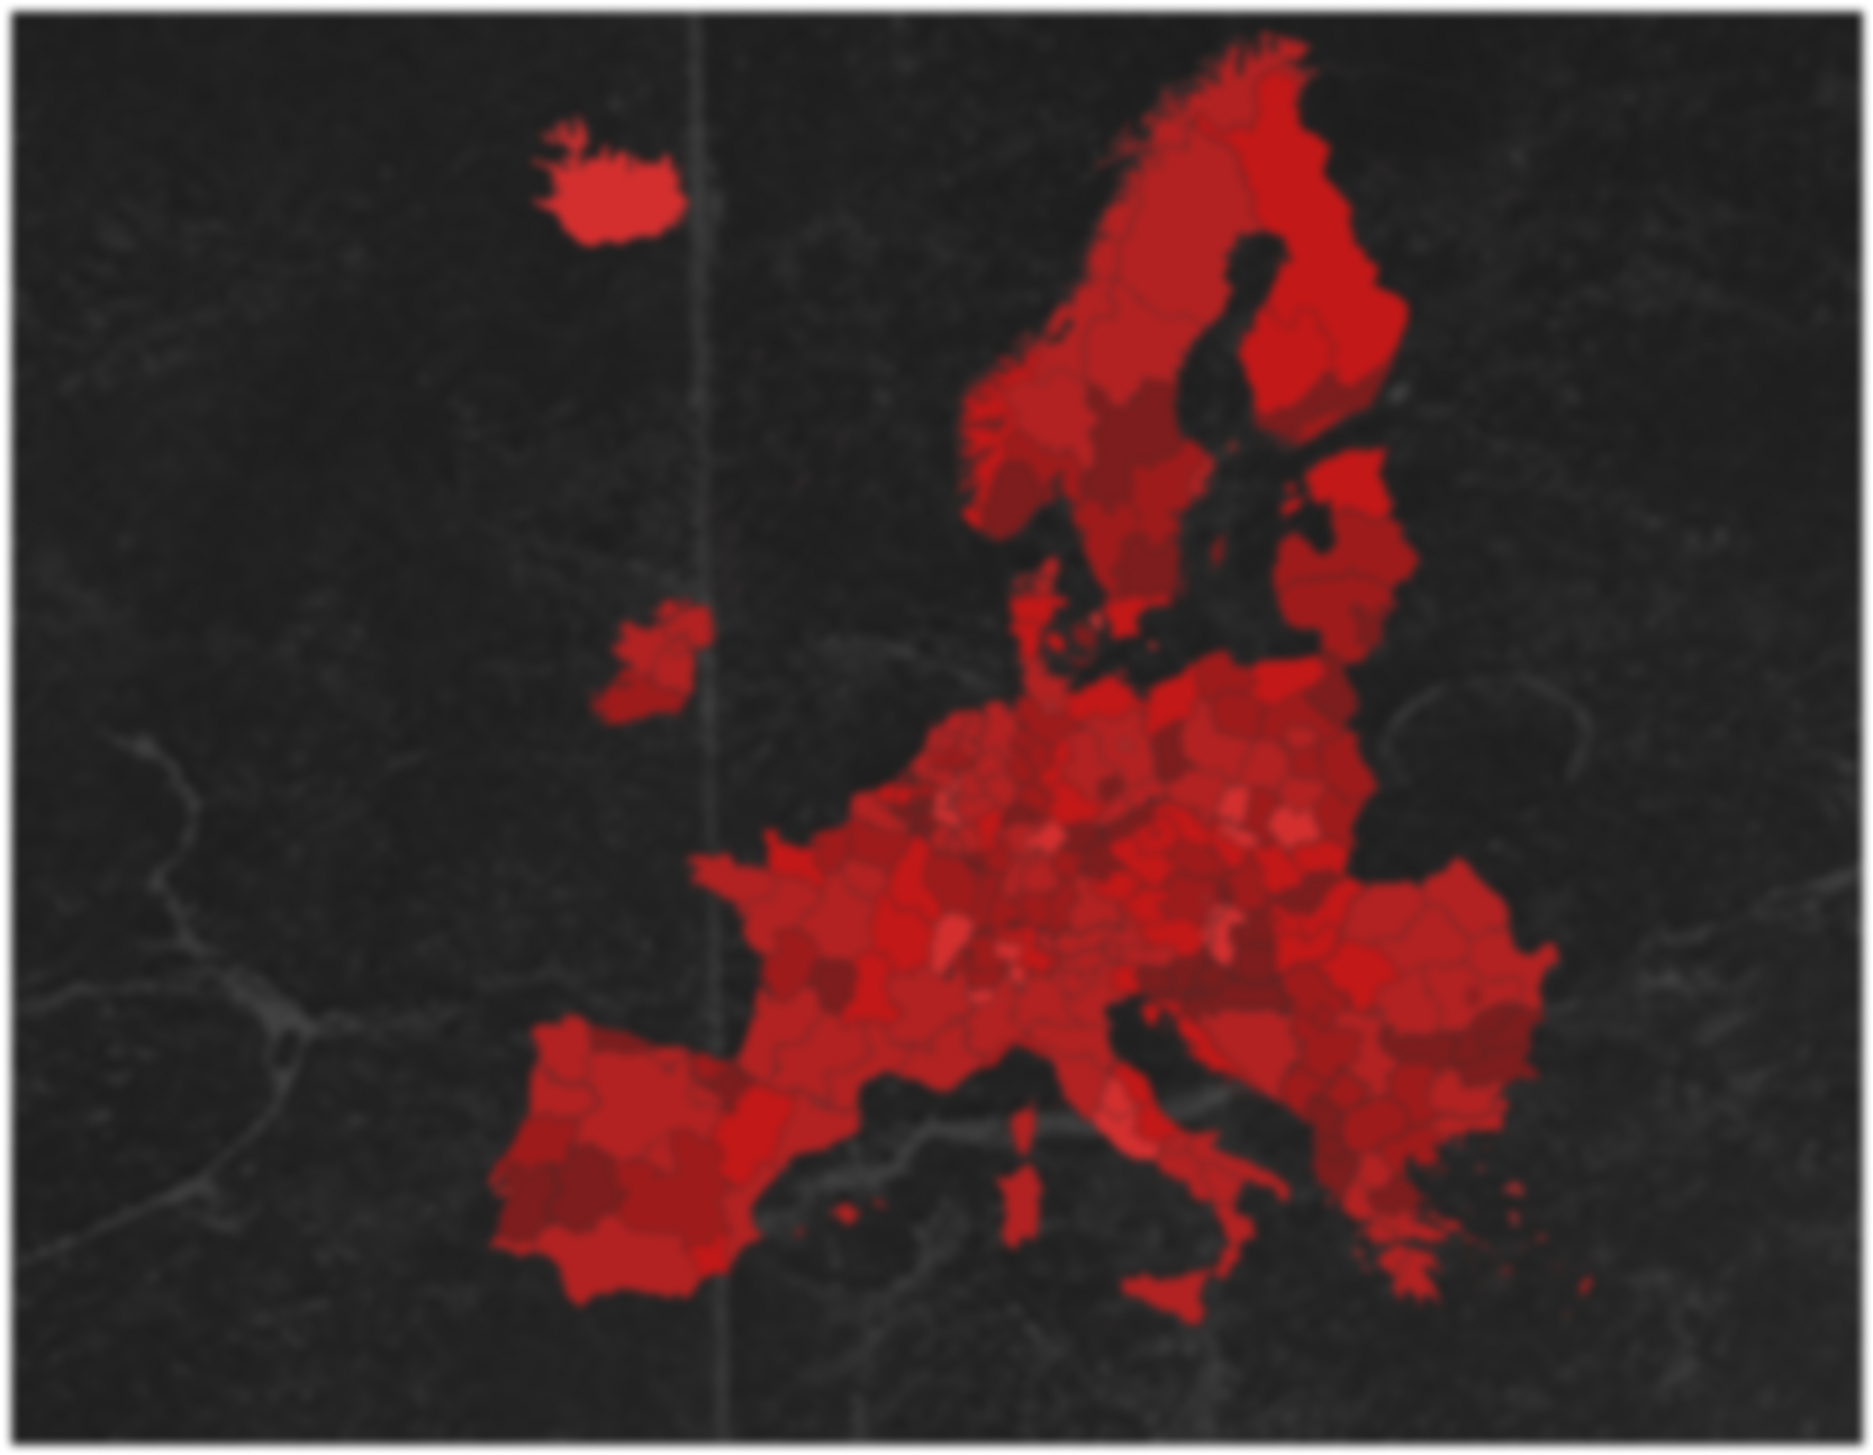

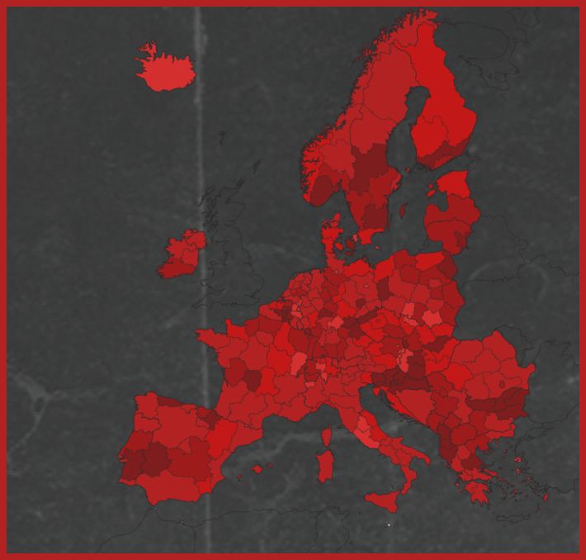
BEYOND THE MAP Decoding Europe’s crimes
CRIMES IN EUROPE
Made by
Neagu Andrei
Litescu David-Adrian
Dinca Alexandra-Maria
Al Sammarraie Nooruldeen

Slide 2
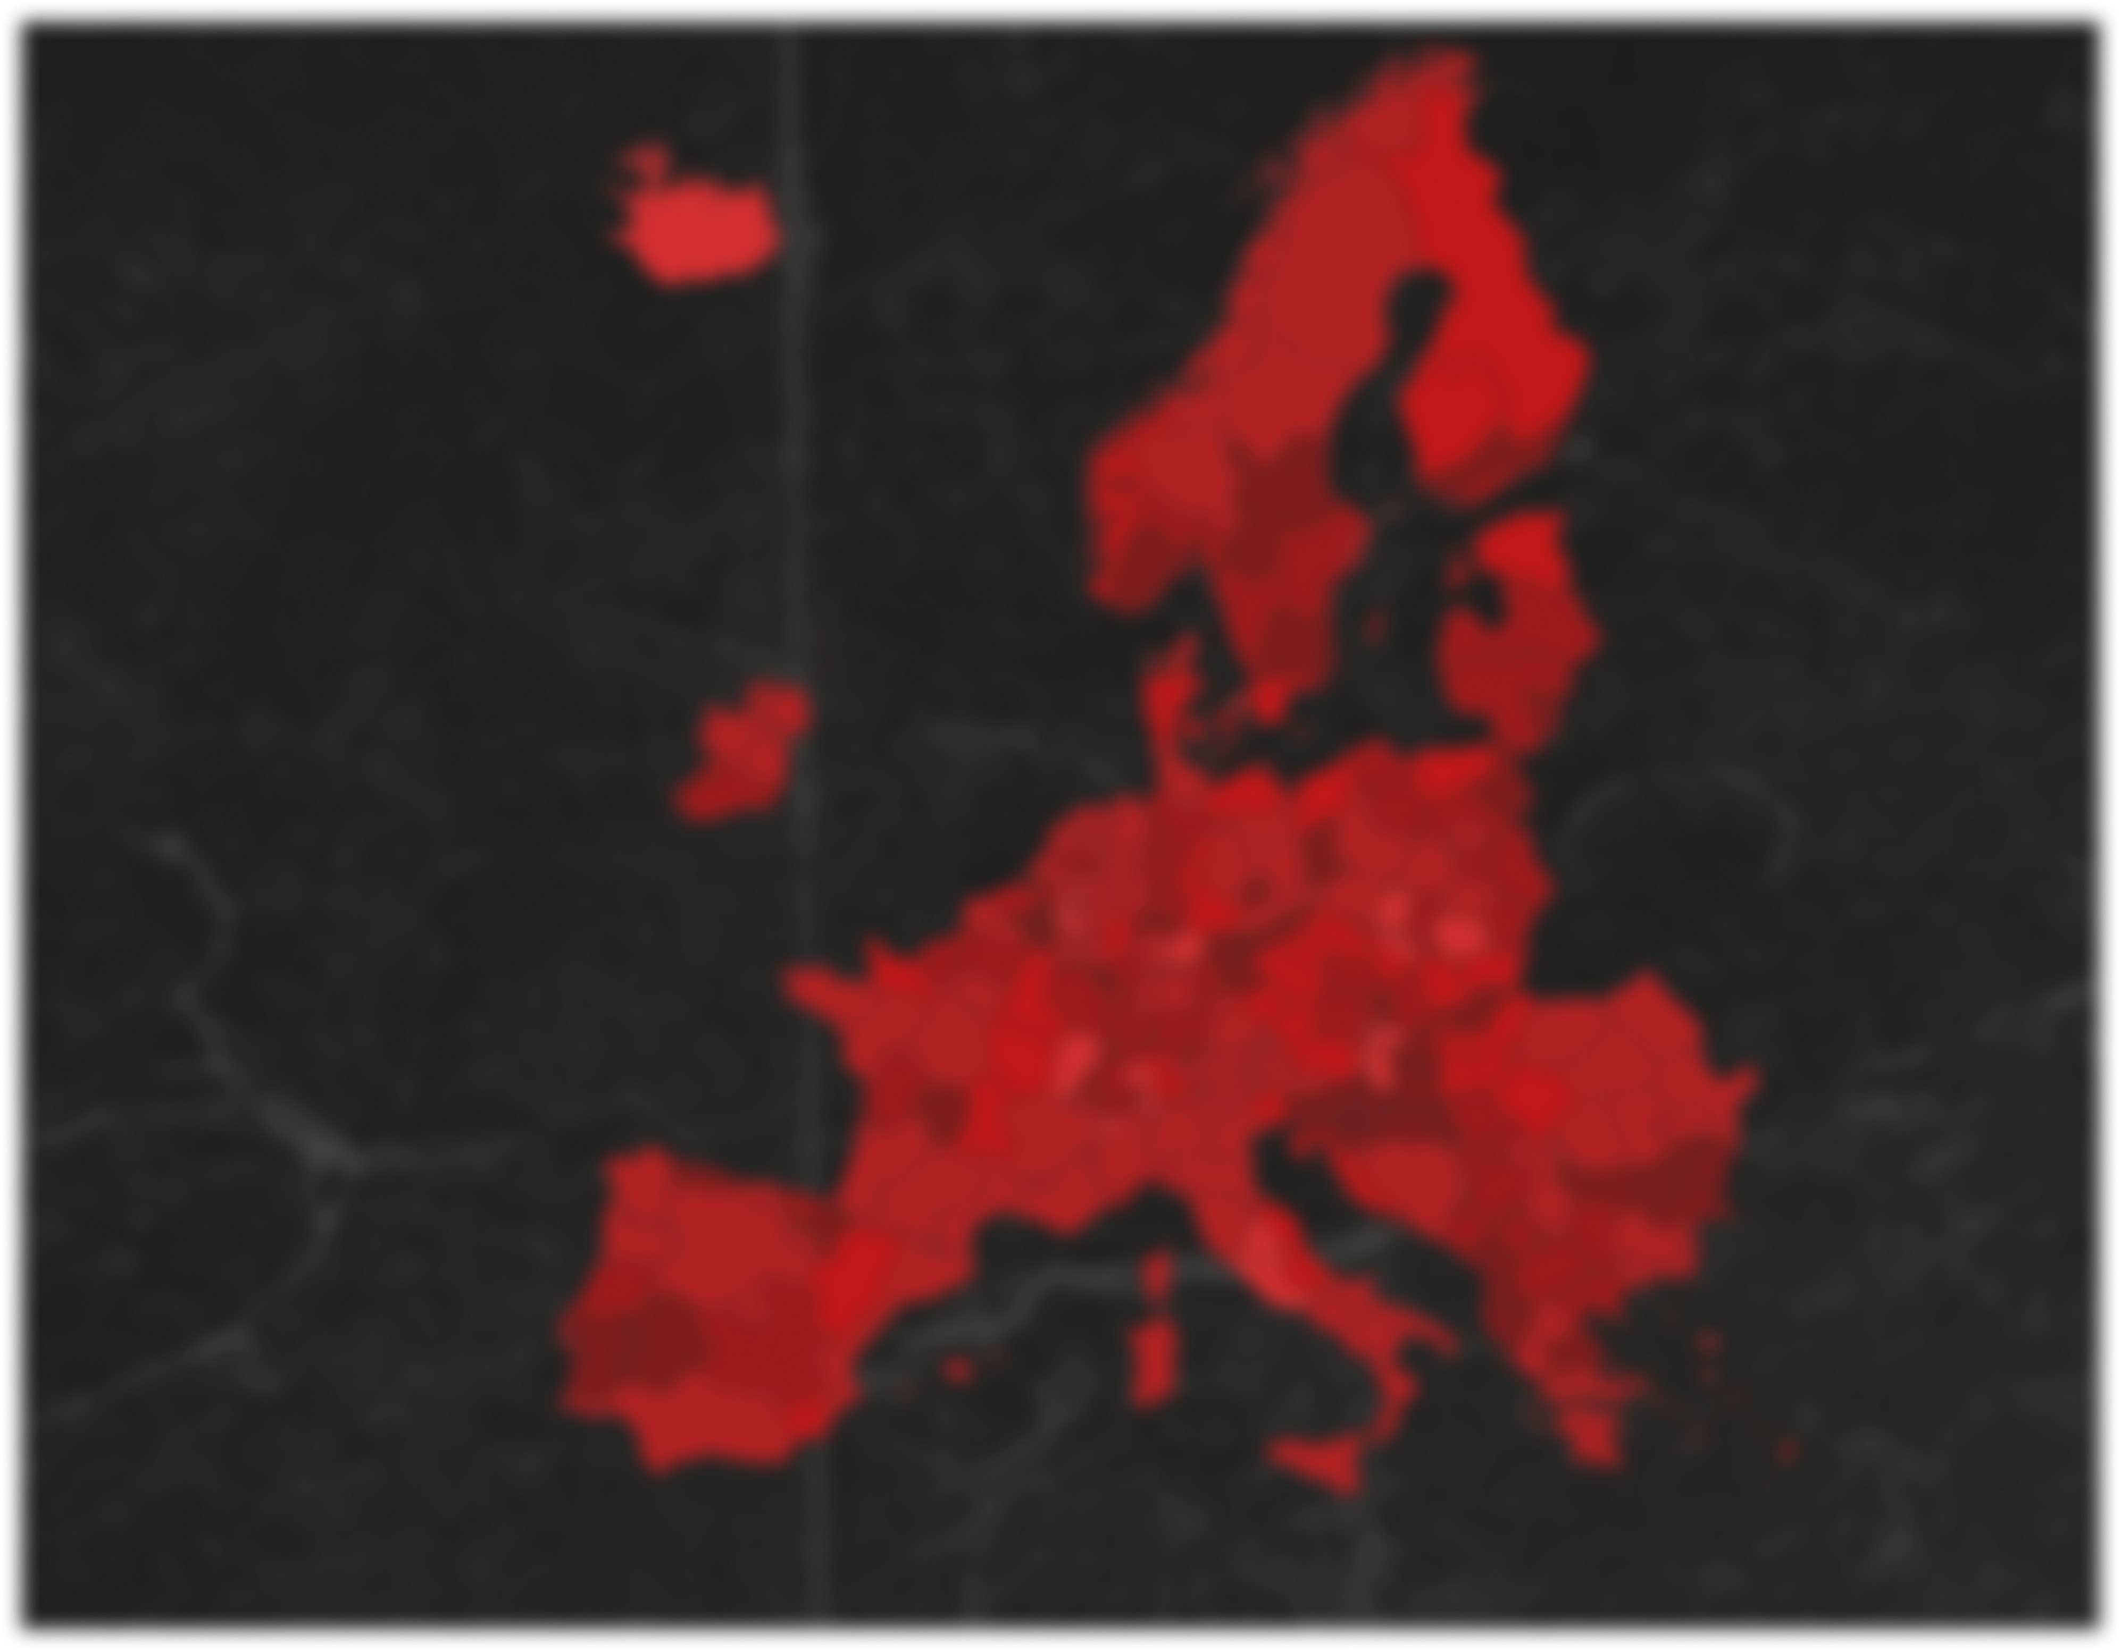
CRIMES IN EUROPE
Literature Review
In this study we have focused on examining social, economic and educational indicators in EU regions at NUTS 2 level using data collected from Eurostat.
We want to show how the education level, the employment status and the income of people in a region can affect the crimes that occur in that region, focusing on theft-related crimes.

Slide 3
Literature Review
03
01
SOURCES
🔸 Economic Models of Crime
Several models show that individuals weigh the risks and rewards of crime. For example, unemployment can push people toward crime due to lack of legal opportunities.
🔸 Criminal Earnings & Dynamics
Other models explore how earnings from crime and external factors like neighborhood conditions shape long-term criminal behavior.
🔸 Role of Education
Education plays a major role, higher levels of education, especially among youth, are linked to significant drops in crime.
🔸 Social Class & Crime Types
The type of crime can also vary by region and social class. Robberies are more common in poorer areas, while burglaries often target wealthier households.
02
Economic Models of Crime:
Becker/Ehrlich model suggests individuals weigh crime benefits vs. costs.
Labour market factors (e.g., unemployment) influence crime rates.
Role of Education:
Higher education levels lower crime, especially among youth (Rochester Center, 1999).
Education is the most impactful on richest & poorest groups (Abdul Abdullah et al., 2013).
Social Class & Crime Types:
Social class affects both crime type and legal defense (Costelloe & Michalowski, 2014).
Robbery is more likely in low-income areas Burglary in wealthier areas.
04
05

Slide 4
THE VARIABLES
`
Population
Education
Income
Unemployment
Robberies
Burglaries
THE METADATA
The total Population of each region
The Level of Unemployment for each region
The Number of Robberies recorded per region
The percentage of People that have finished a tertiary level of education
The Total Income of Households per
region
The Number of Burglaries recorded per region
`

Slide 5
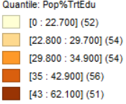
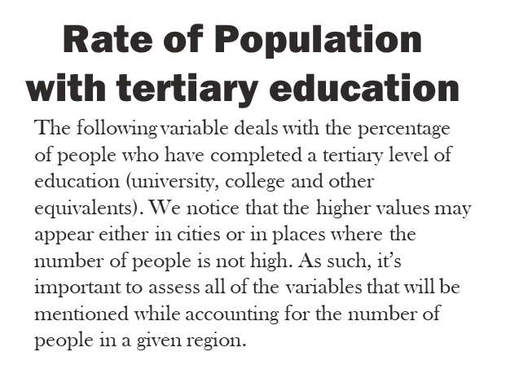
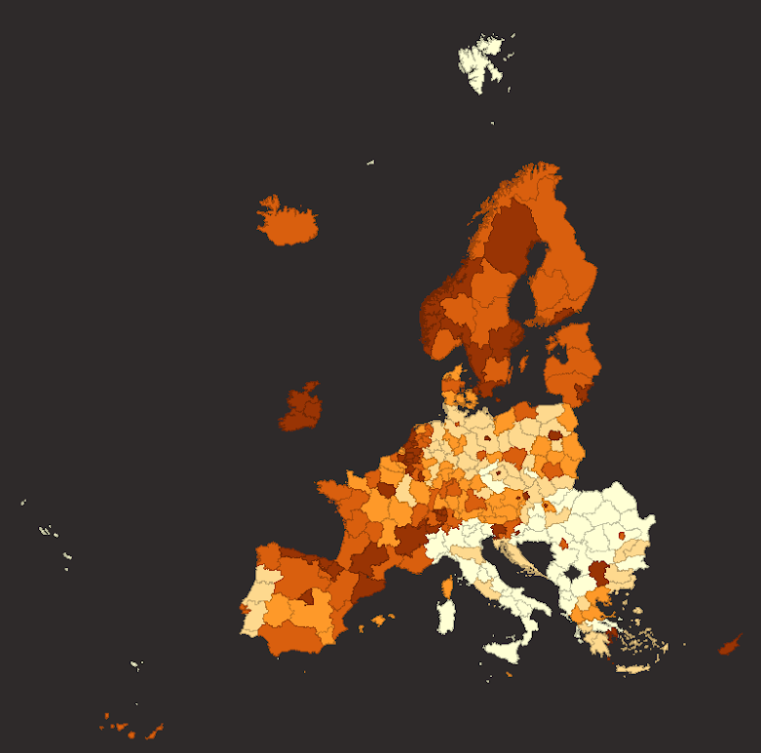
Data analysis:
We decided to start analyzing how our variables are spatially represented using quantile maps for each variable. 5 quantiles were chosen as they provide more granularity than quartiles, and it helps us spot any spatial patterns and trends, detect possible outliers and highlight the relationships between the data and the demographic features.
`

Slide 6
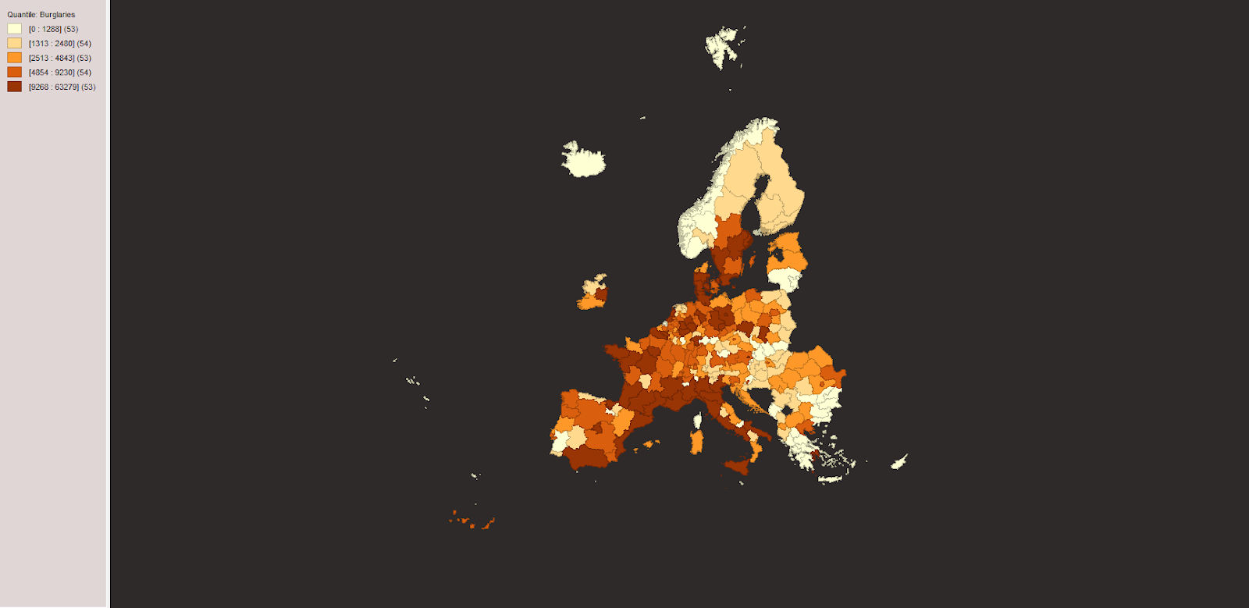
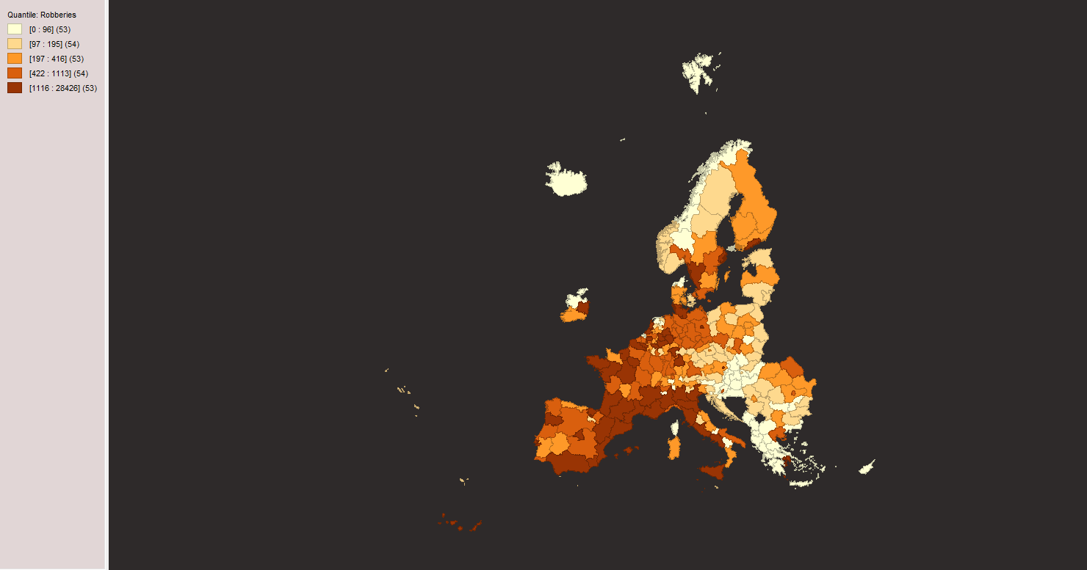
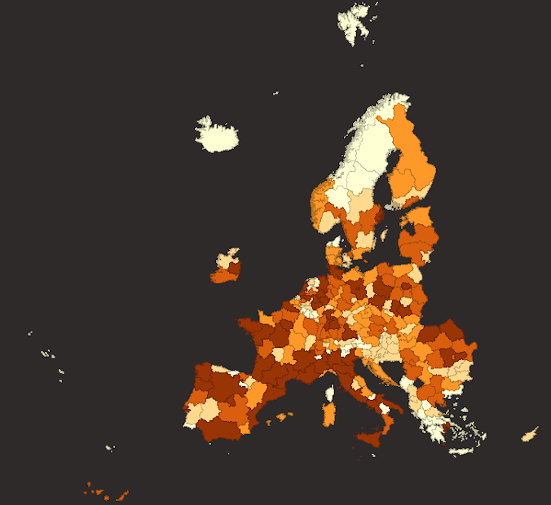
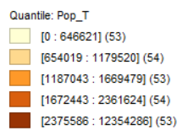
Population total
Robberies
Burglaries
Rate of Population with tertiary education
The following variable deals with the percentage of people who have completed a tertiary level of education (university, college and other equivalents). We notice that the higher values may appear either in cities or in places where the number of people is not high. As such, it’s important to assess all of the variables that will be mentioned while accounting for the number of people in a given region.
This variable shows the total number of people within a given region. As seen in the picture, the regions which have a higher concentration of people are the metropolitan areas and the capitals of each country.

Slide 7
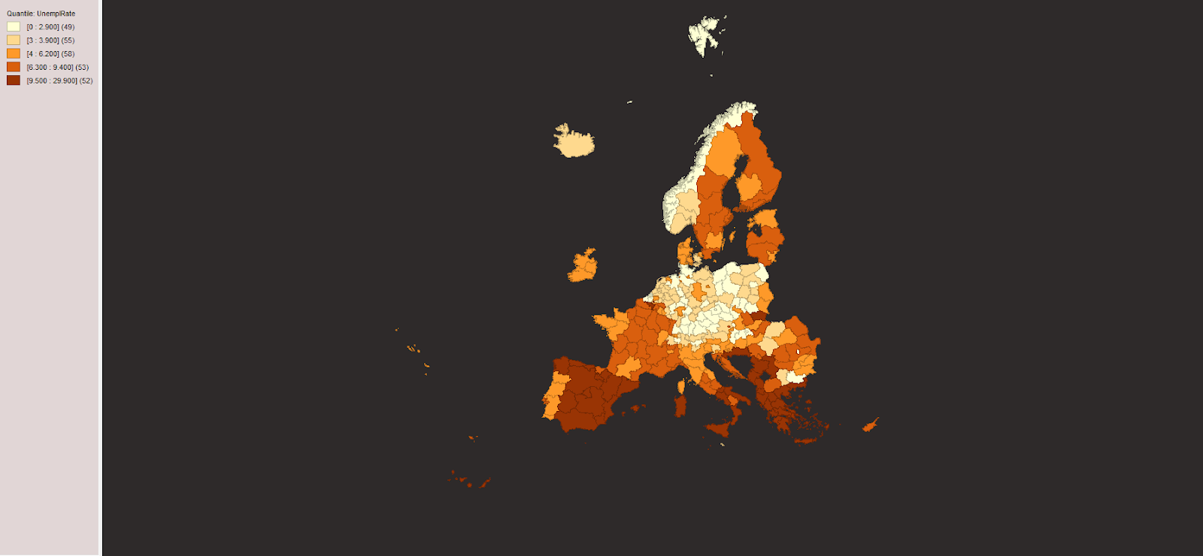
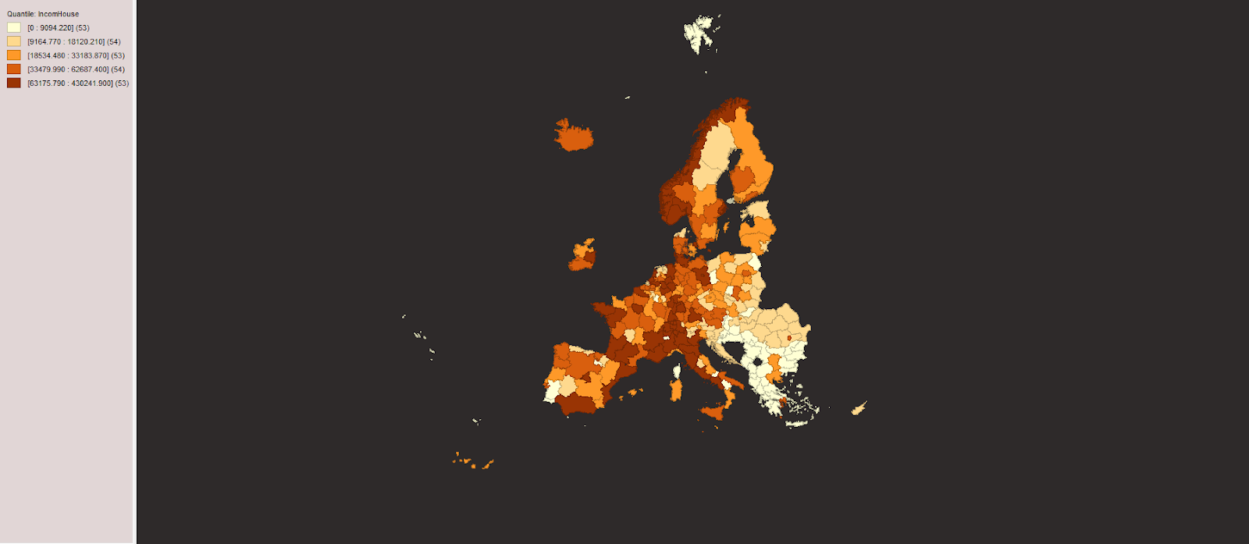
Robberies
Burglaries
We have decided to analyze two of the most common recorded offences that may occur based on the education level and the income available to citizens of a given region: robberies and burglaries. In the two maps shown, we can notice hotspots created in about the same areas for both variables, showing the likelihood of both occurring given a few factors. For the Northern countries of the continent, it seems that the level of observations recorded is quite small, given the number of people recorded there is small and because the higher income level and the reduced unemployment rate (variables which will be analyzed shortly) are also more economically favorable. In contrast, for some regions like Spain, Italy, Greece, the education level, while high, doesn’t show a decrease in the crimes recorded, and that seems to be because of the unfavorable economic situation present.
`

Slide 8
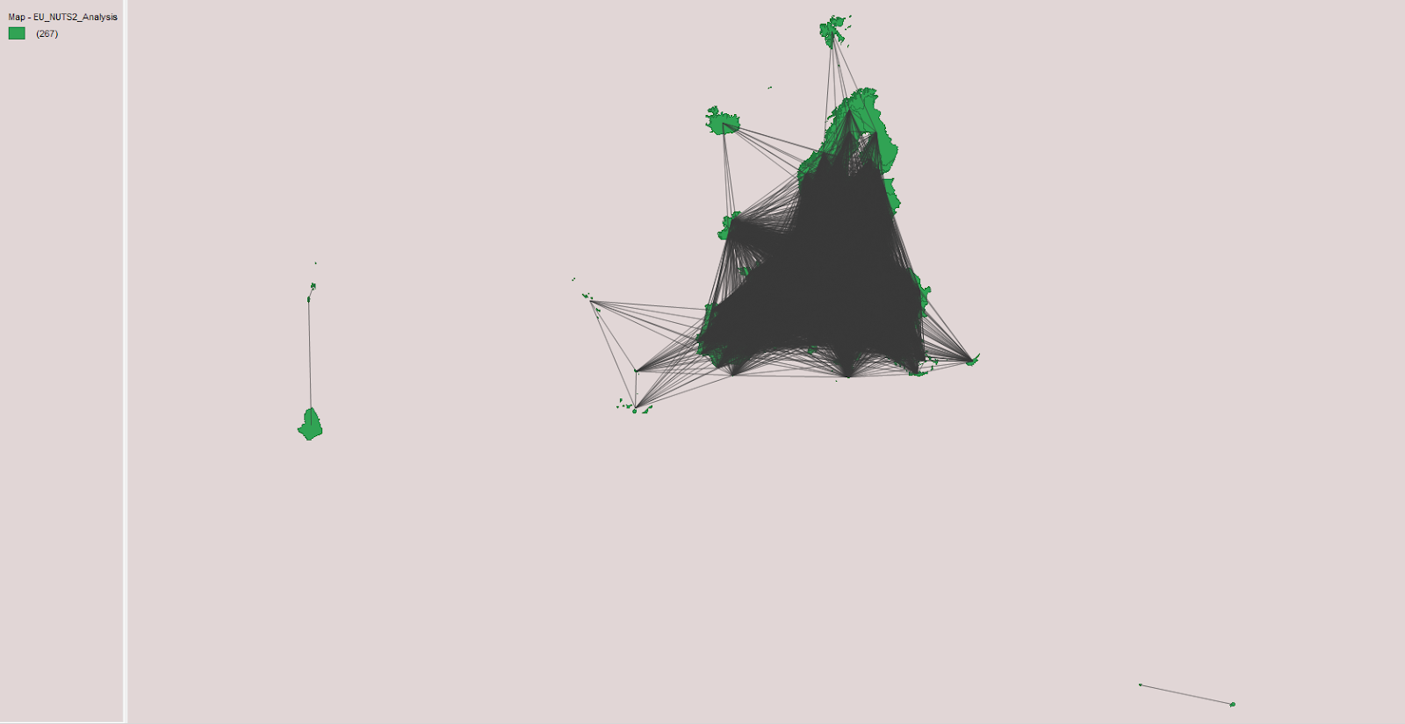
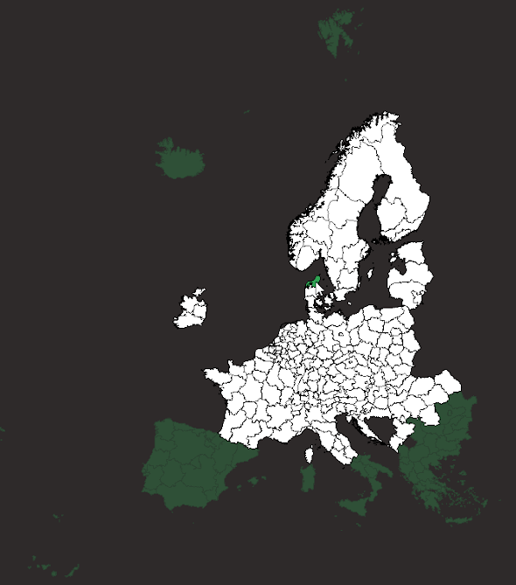
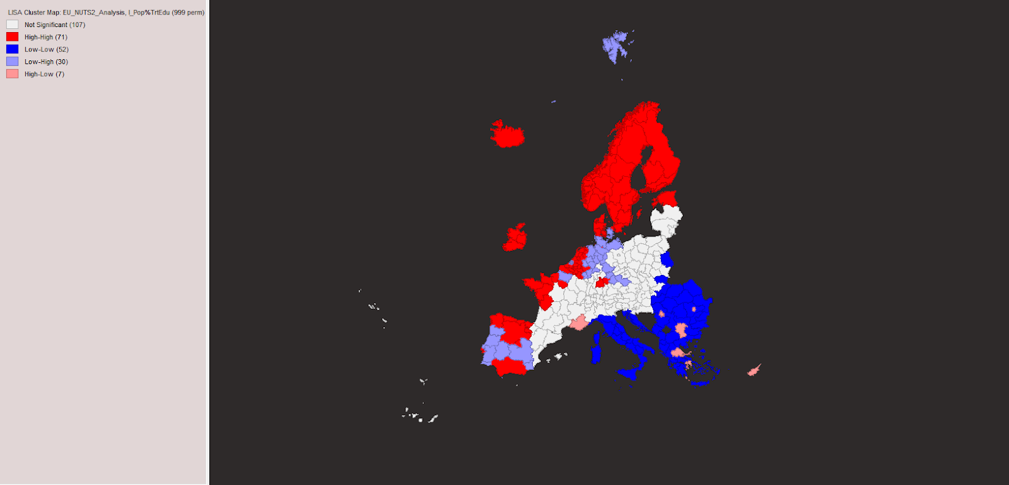
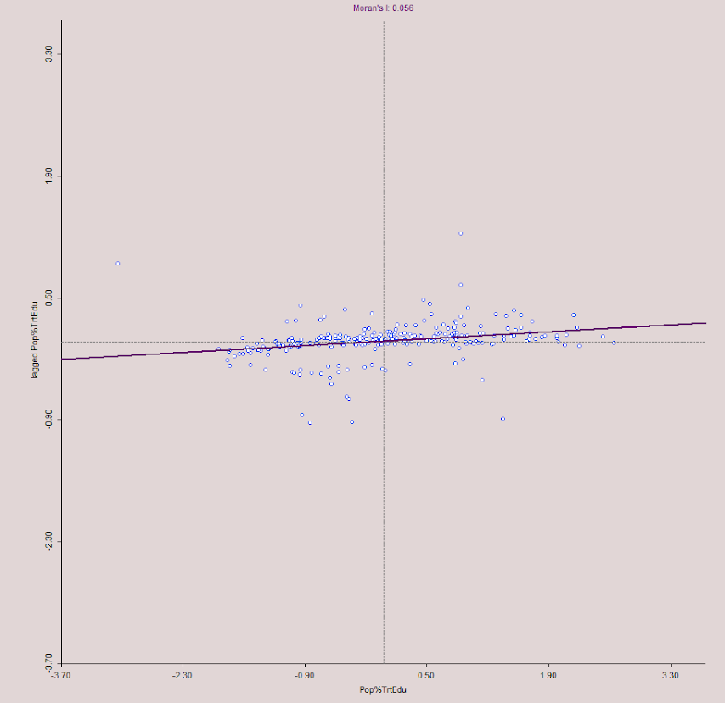
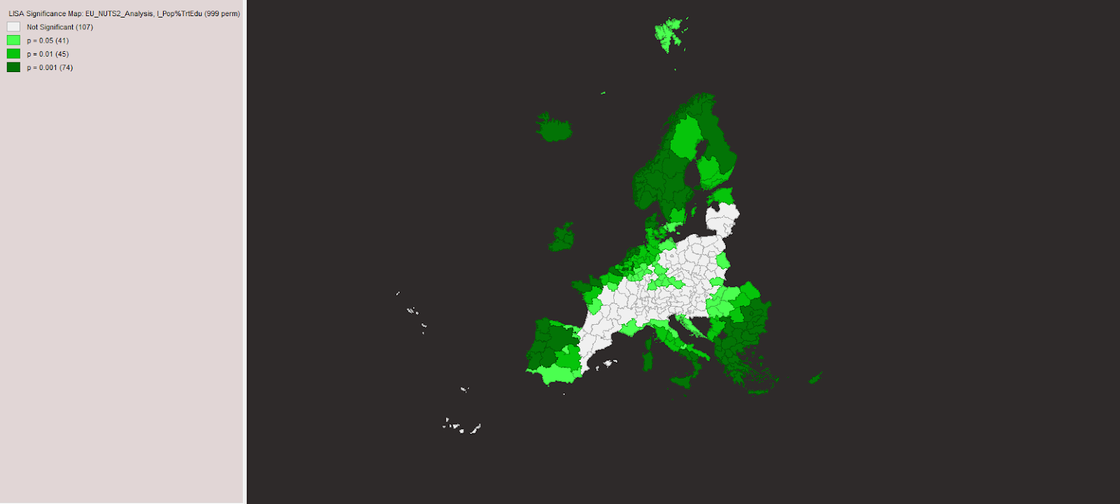
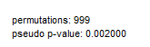
Unemployment
Income per household
The unemployment rate is one of the measures used to understand both the economic situation and the quality of life that a citizen in a region experiences. As stated before, having issues finding a job may lead people to turn to a life of crime. Additionally, people prefer working higher income jobs, and those may be harder to find in an area with more individuals, and such some people may end up searching for jobs for a longer period of time.

Slide 9
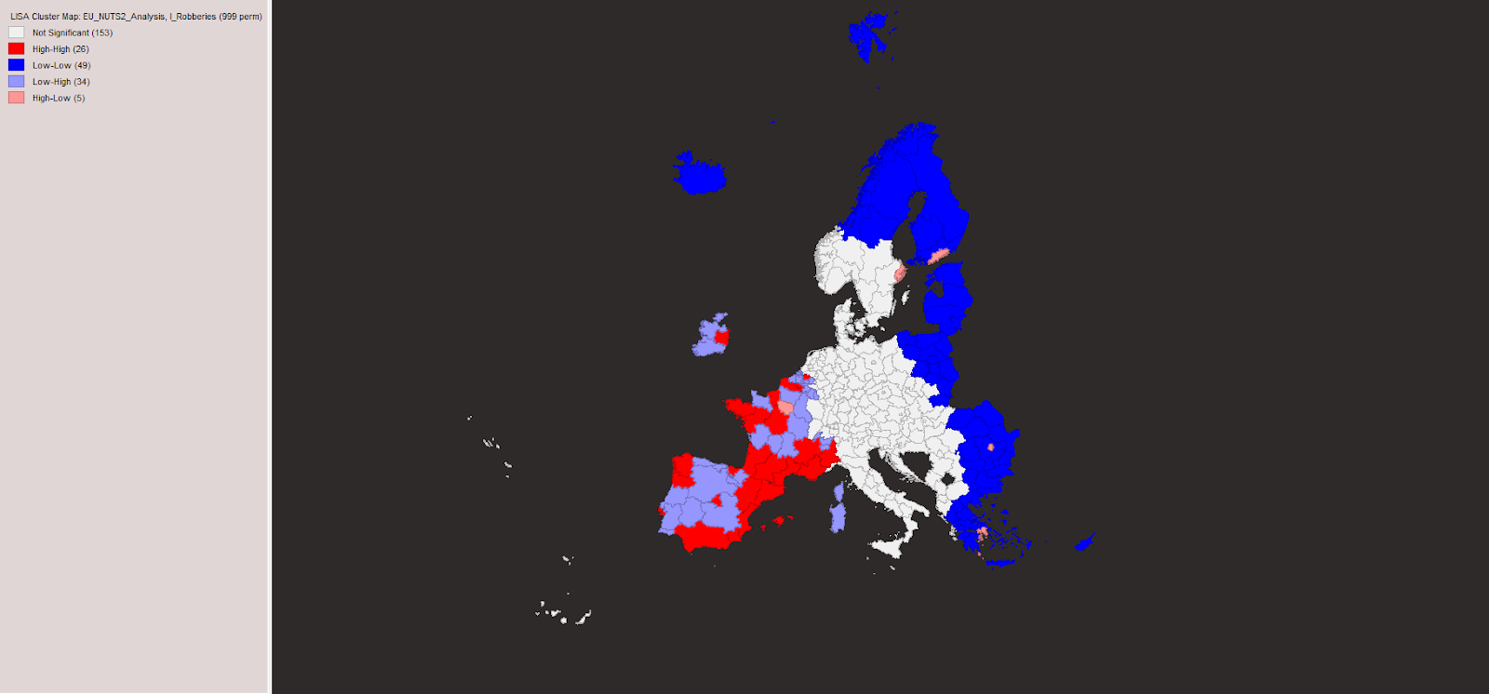
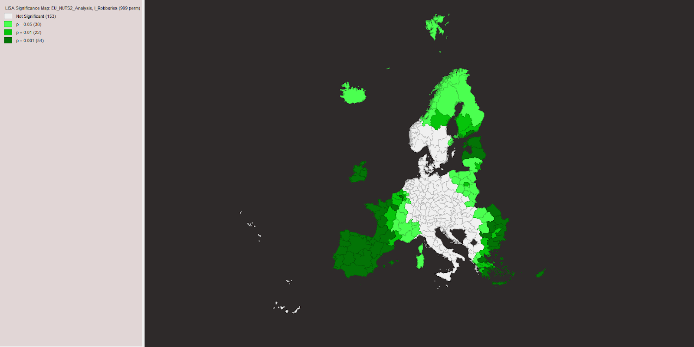
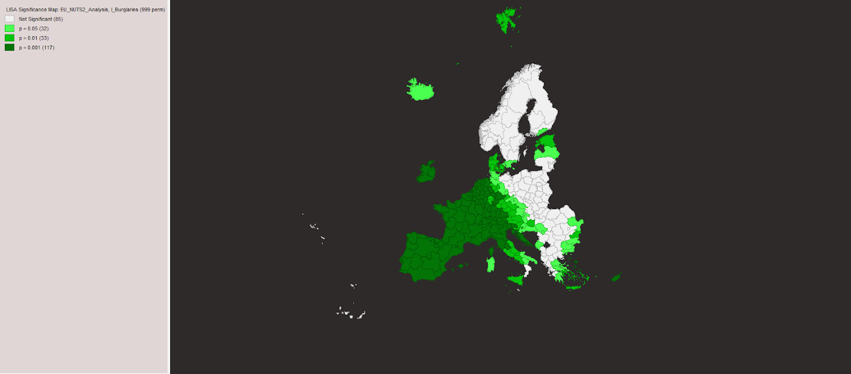
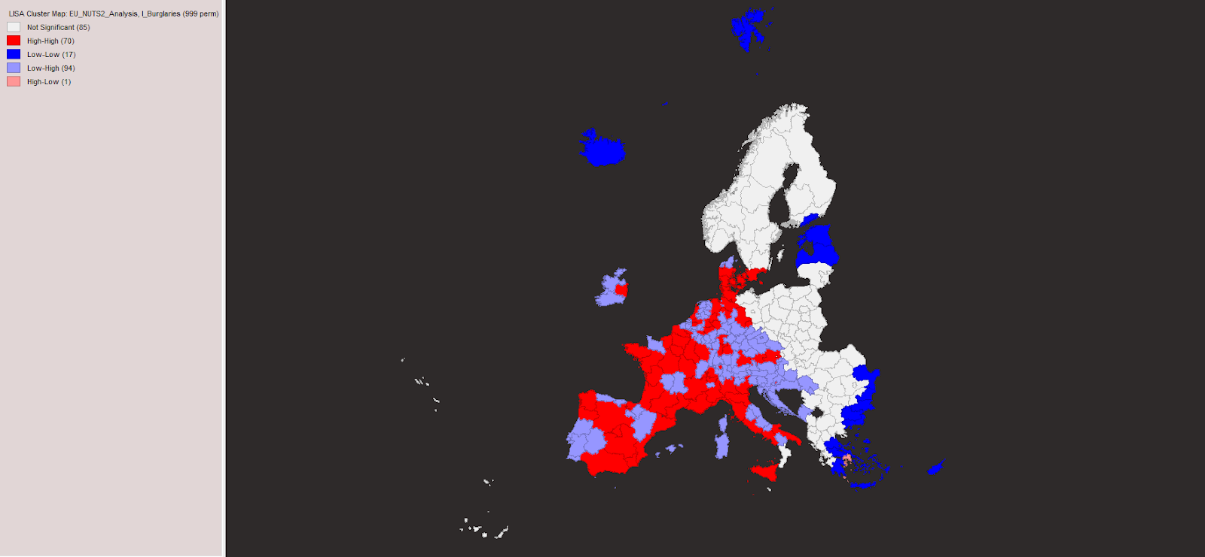
Spatial Analysis
Univariate
Education
We identify that most of the regions fall into the High-High category . This means that if a region has a high percentage of population that completed tertiary education, its neighboring regions also have a high percentage of population that completed tertiary education, suggesting spatial spillover.
We have a significant (p-value = 0.002 < 0.05) low positive spatial autocorrelation (Moran’s I = 0.056), which shows similarities between the regions of the EU.
The next category of regions is Low-Low
So we also have spillover.

Slide 10
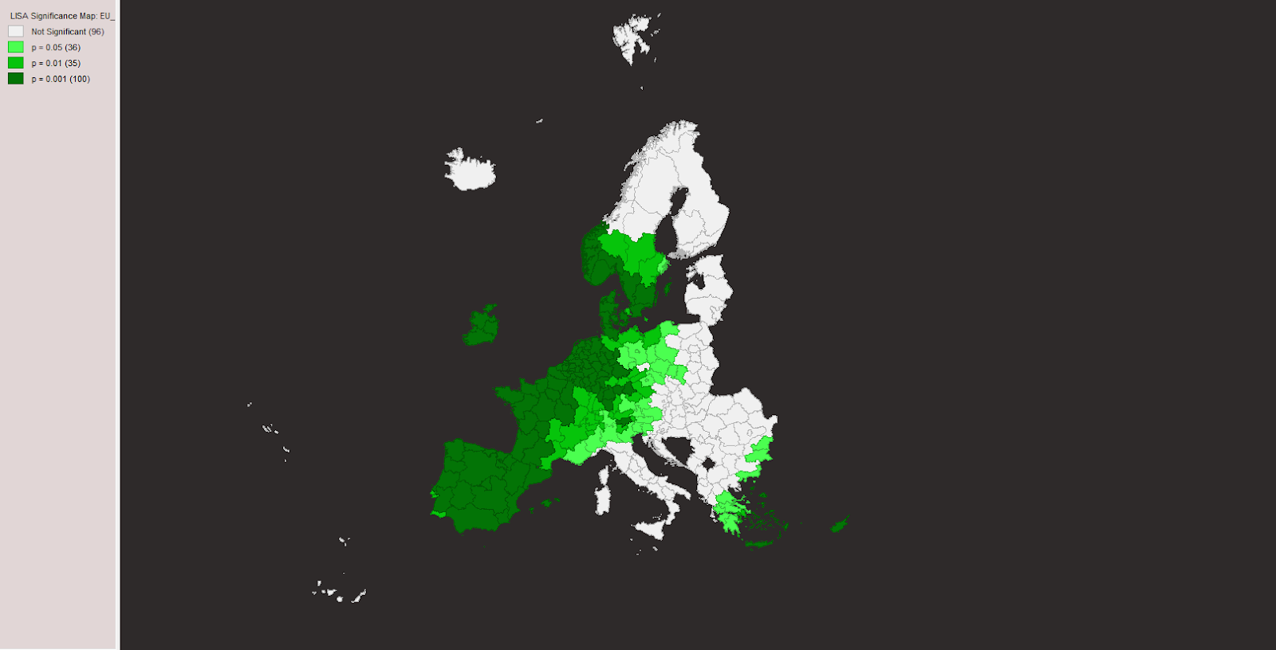
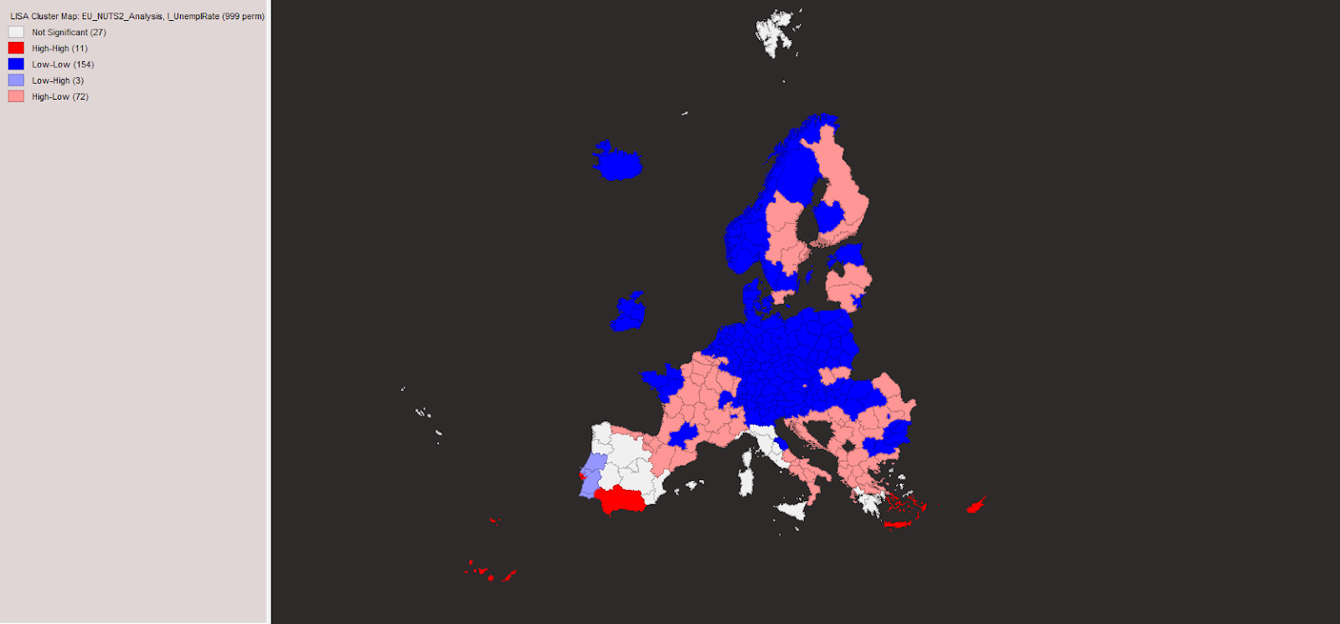
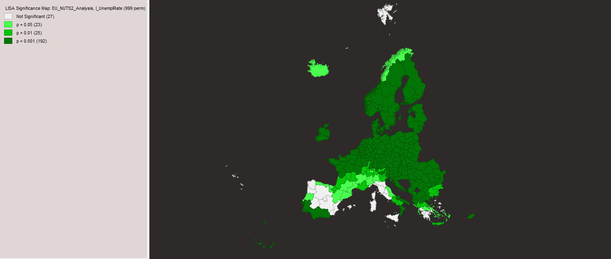
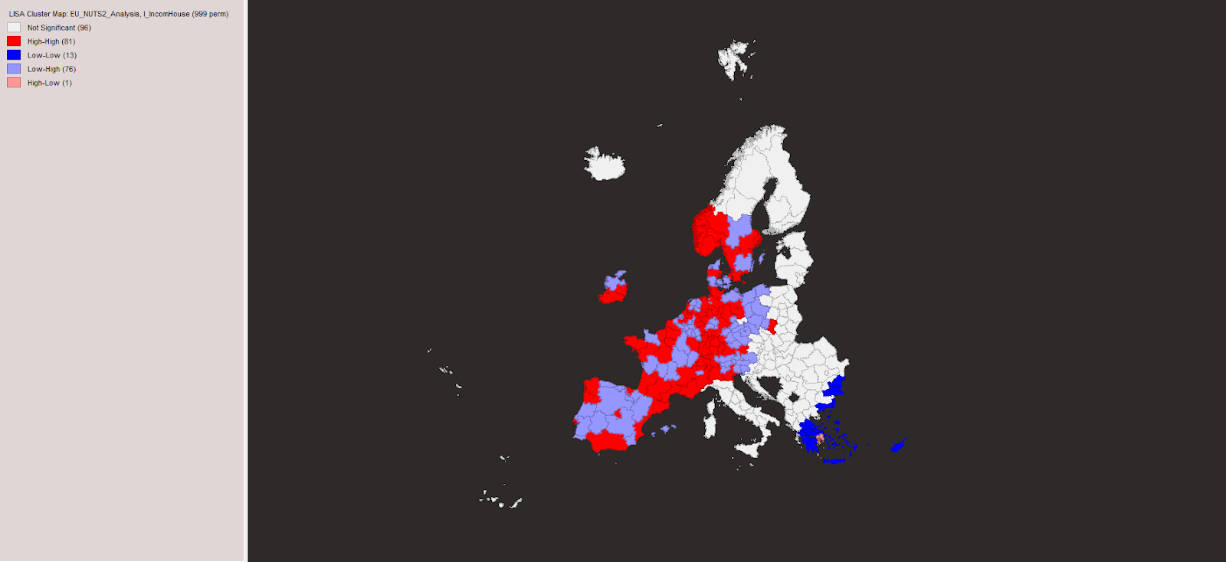
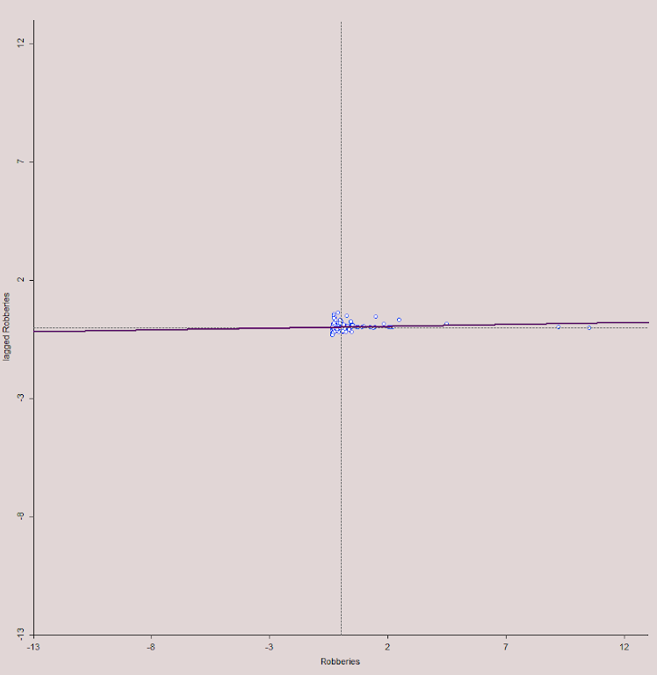
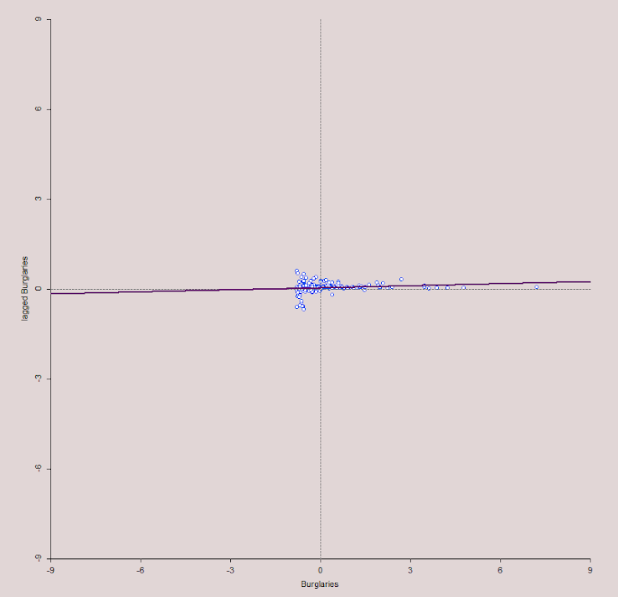
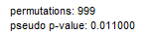
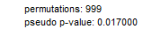
`
Robberies
Burglaries
The spatial spillover for both of these variables is quite similar, the categories that are present being low-low, low-high, and high-high, suggesting that for both robberies and burglaries tend to clutter together. We can also observe that for regions with a low level of crime, neighboring regions can present either low or high, depending more on the income, unemployment rate and demography of the place.
We have a significant (p-value = 0.011 < 0.05) low positive spatial autocorrelation (Moran’s I = 0.016), which shows similarities between the regions of the EU.
We have a significant (p-value = 0.017 < 0.05) low positive spatial autocorrelation (Moran’s I = 0.024), which shows similarities between the regions of the EU.

Slide 11
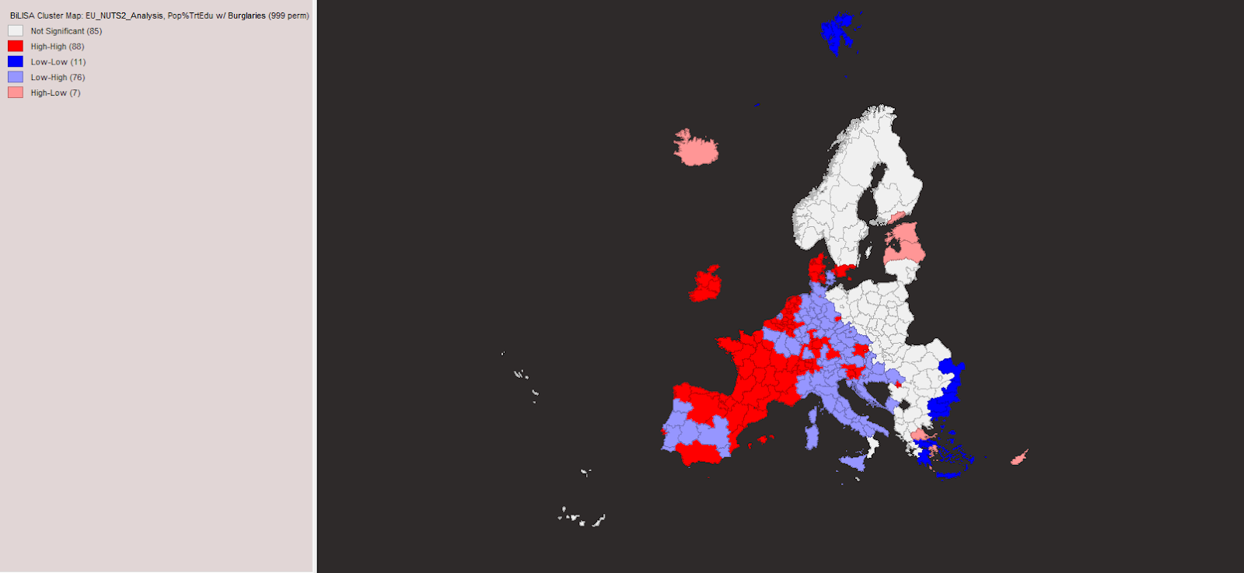
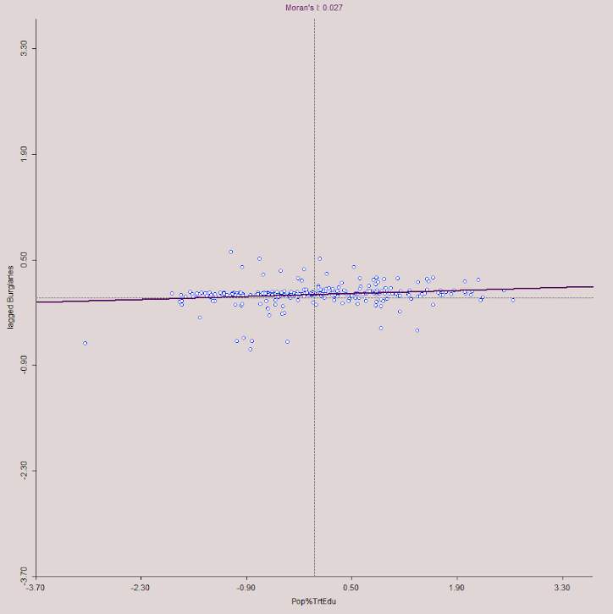
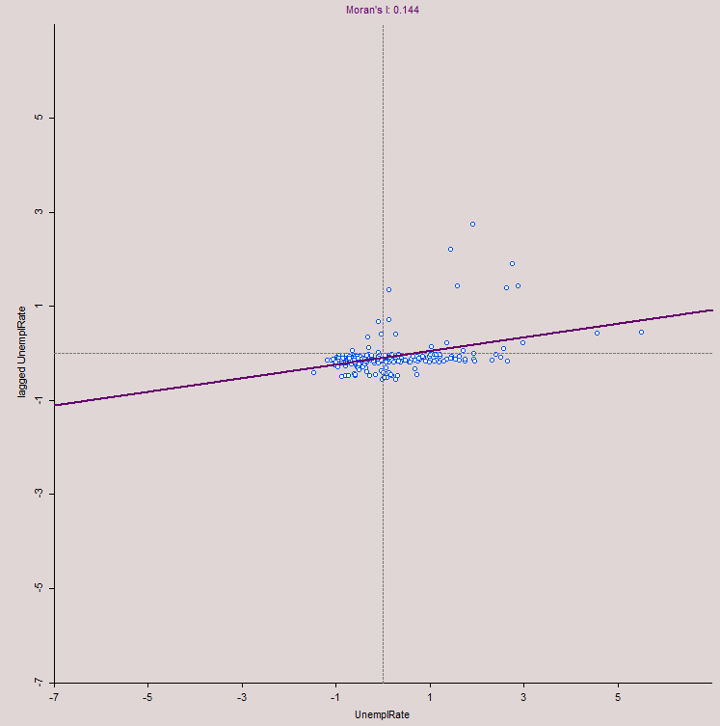
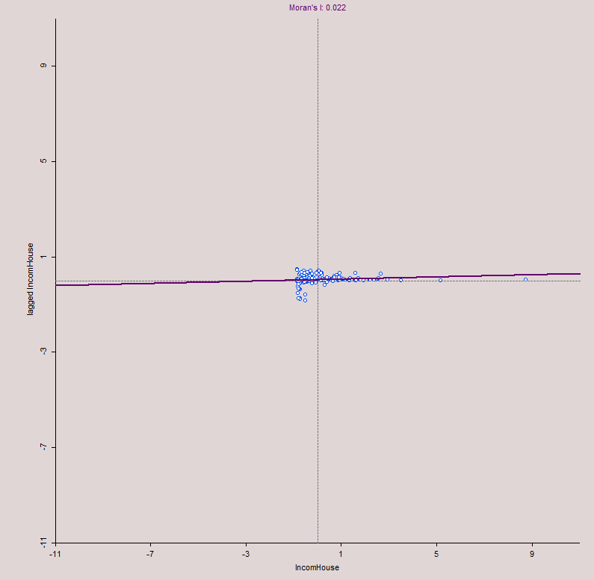
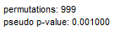
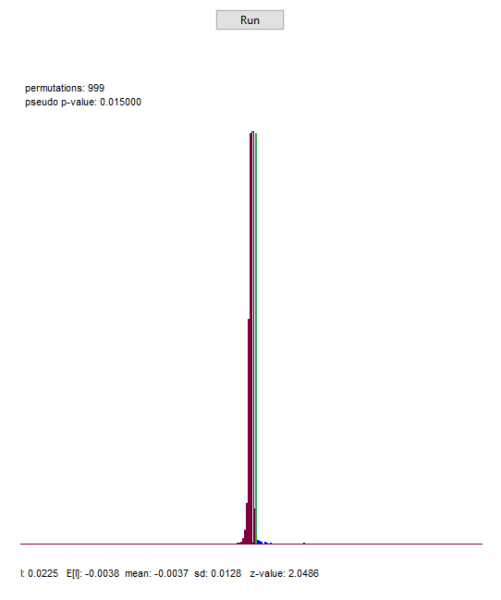
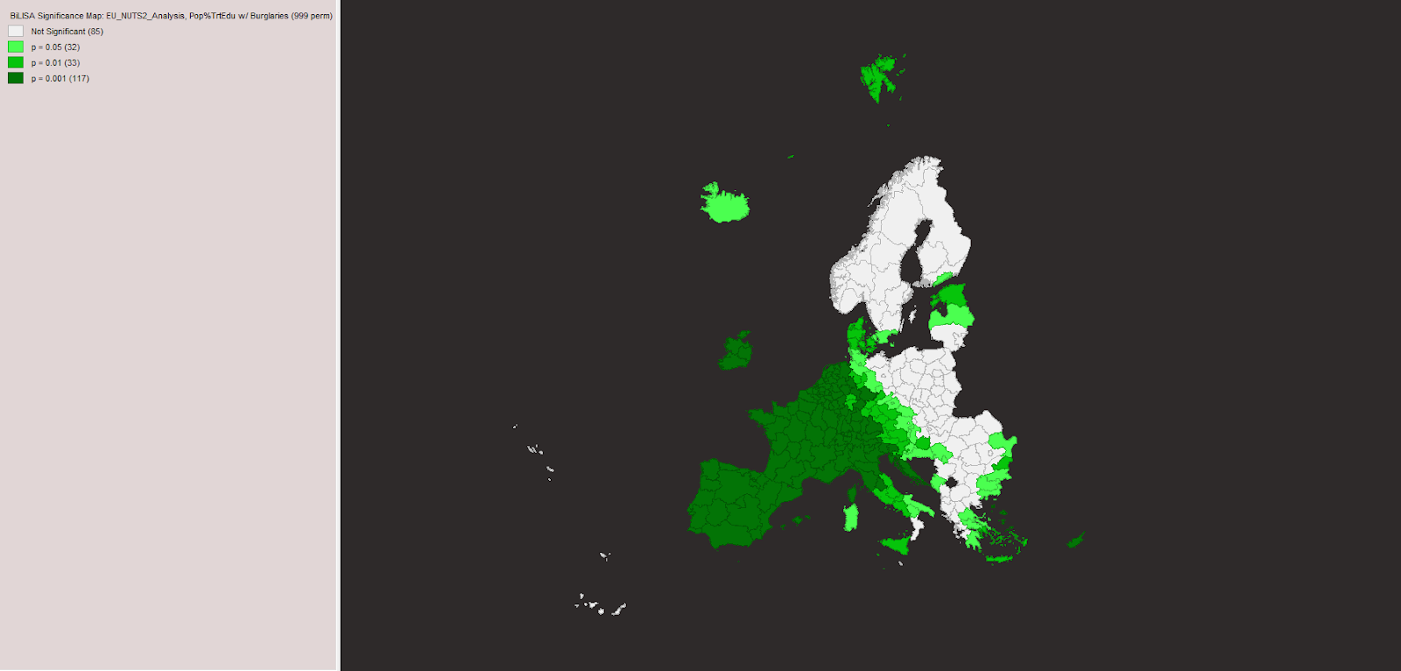
Unemployment
Income
The prevalence of Low-Low unemployment clusters (154 regions) highlights the presence of spatial spillovers, where regions with low unemployment rates are geographically near to others with similarly low rates, suggesting shared economic conditions. Conversely, the identification of High-Low unemployment clusters (72 regions) underscores spatial disparities, where regions with high unemployment rates are bordered by regions with low unemployment, possibly reflecting stark contrasts in regional development, infrastructure, or resource distribution. Additionally, the clustering of High-High household income regions (81 regions) further emphasizes the spatial spillover effect, indicating regional advantages such as access to better education, job opportunities, or amenities.
We have a significant (p-value = 0.001 < 0.05) low positive spatial autocorrelation (Moran’s I = 0.144), which shows similarities between the regions of the EU.
We have a significant (p-value = 0.015 < 0.05) low positive spatial autocorrelation (Moran’s I = 0.022), which shows similarities between the regions of the EU.

Slide 12
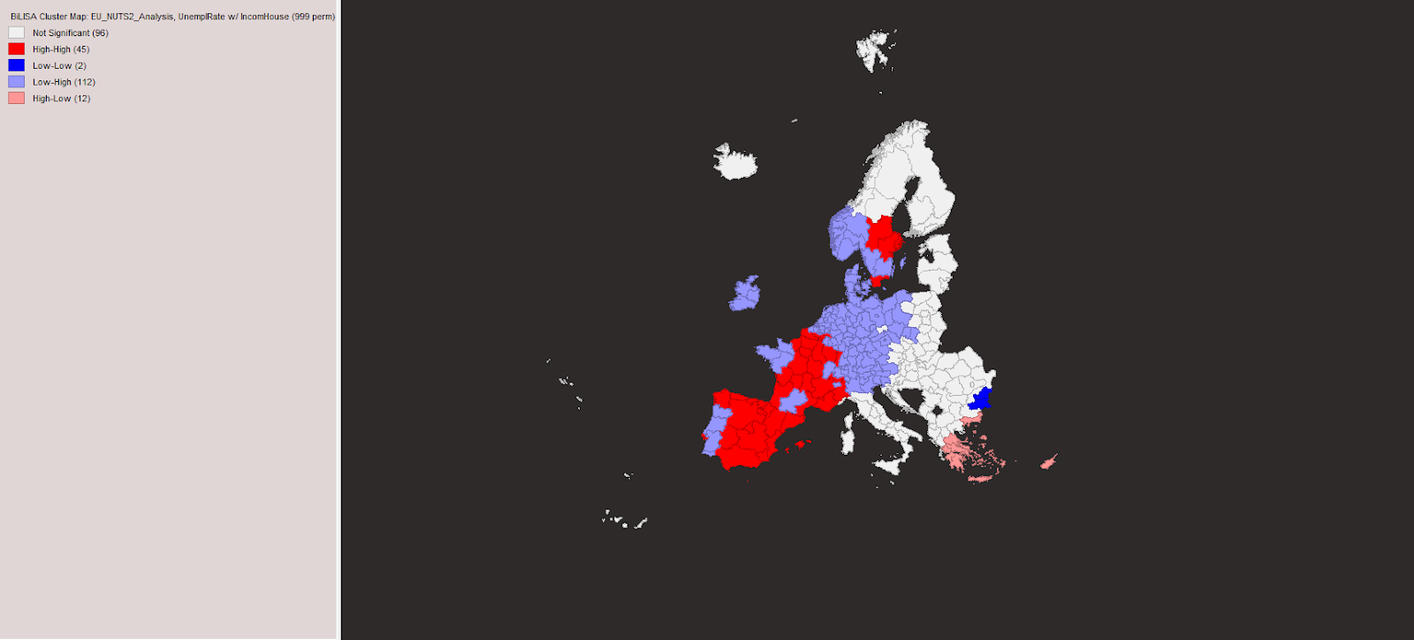
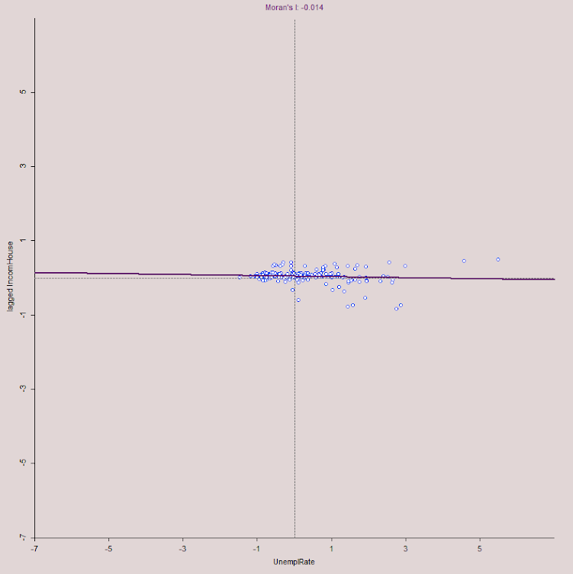
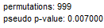
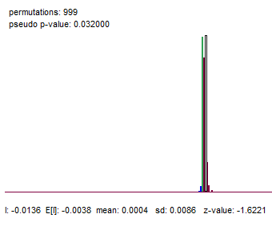
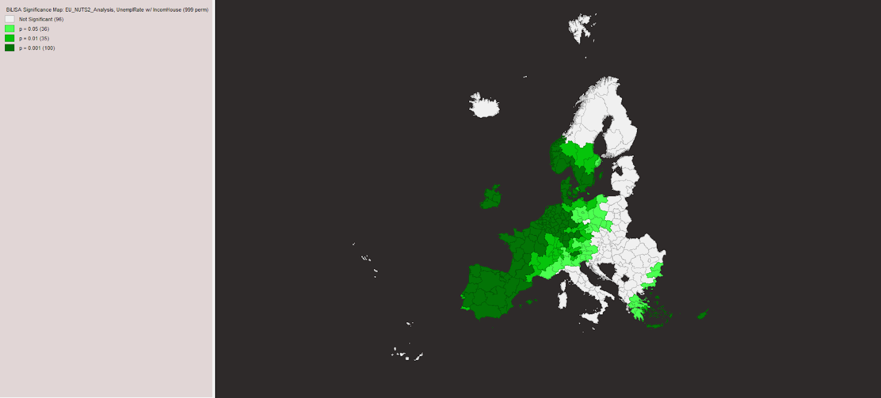
Bivariate analysis:
Level of education and crime
When analyzing the relationships between the two types of crime that we picked, an interesting pattern occurred, certain regions that are characterized by a low percentage of the population that completed tertiary education have their neighbors with a high number of crimes. This may occur because of a few reasons:
Economic and social Inequality:
Areas with a low education level may persuade people into leaving to neighboring regions, in order to find higher property values and wealthier households.
Urban-Rural Gradient:
Urban areas, which might be the neighbors of regions with low education levels, often exhibit higher crime rates due to greater anonymity, higher population density, and economic disparities. Regions with low tertiary education levels are often rural or less developed areas.
`
We have a significant (p-value = 0.007 < 0.05) low positive spatial autocorrelation (Moran’s I = 0.027) between the percentage of the population that achieved tertiary education and the number of burglaries. If a region has a high percentage of the population that achieved tertiary education, then its neighboring regions may have a high number of burglaries and vice versa.
Notes:
which may have lower crime rates themselves but are adjacent to urban regions with more opportunities for criminal activity.

Slide 13
CONCLUSIONS
Income of households and unemployment rate.
It is quite obvious that a higher unemployment rate leads to a lower income on each household, as identified by the fact that most regions fall into the Low-High category (112 regions). This pattern reflects uneven socio-economic conditions across neighboring regions.
However, the presence of the group of High-High regions can also be observed, While this might initially suggest clustering, this pattern reflects localized contrasts or specific regional dynamics. For instance, urban regions with high unemployment rates might still maintain high household incomes due to economic diversity or regional wealth concentration.
Notes:
which may have lower crime rates themselves but are adjacent to urban regions with more opportunities for criminal activity.

Slide 14
CONCLUSIONS
03
01
SOURCES
From the variables and relationships assessed, we can draw a few conclusions. While a higher level of education is important, as it broadens the horizon of people, it is important only IF attaining it can lead to higher-paying jobs, as those can secure a higher standard of living, leading to population that can rely on the income earned through honest work, without having to succumb to a life of crime.
02
04
05

Slide 15
SOURCES
THANK
01
Population on 1 January by age, sex and NUTS 2 region
https://doi.org/10.2908/DEMO_R_D2JAN
03
Police-recorded offences by NUTS 2 region (robberies and burglaries)
https://doi.org/10.2908/CRIM_GEN_REG
YOU!
Population by educational attainment level, sex and NUTS 2 region (%)
https://doi.org/10.2908/EDAT_LFSE_04
Unemployment rate by NUTS 2 region
https://doi.org/10.2908/TGS00010
02
04
05
Income of households by NUTS 2 region (balance)
https://doi.org/10.2908/NAMA_10R_2HHINC

Slide 16
THANK
Scientific Leader:
Prada Elena Maria
YOU!
Made by
Neagu Andrei
Litescu David-Adrian
Dinca Alexandra-Maria
Al Sammarraie Nooruldeen

